Slide 2
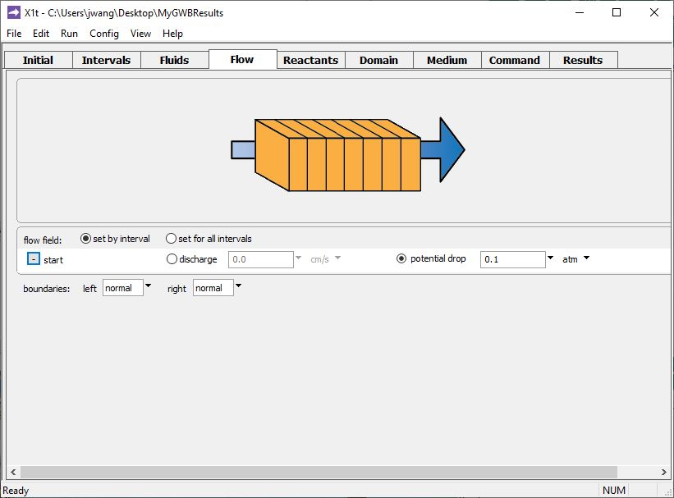
Specify flow rate on the Flow pane.
... or set the driving force for flow (the drop in head or hydraulic potential across the domain).
You can set discharge directly...
GWB will use Darcy’s law to calculate discharge from the viscosity, permeability, and driving force.

Slide 3
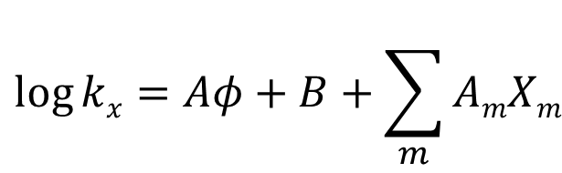
The GWB programs use a correlation to calculate permeability:
$$\log{kx=Aφ+B+\sum_{m}{AmXm}}$$
k_{x} is permeability along x in darcys
Φ is porosity
A, B, and A_{m} are empirical constants
X_{m} are the volume fractions of an
arbitrary set of minerals indexed by m

Slide 4
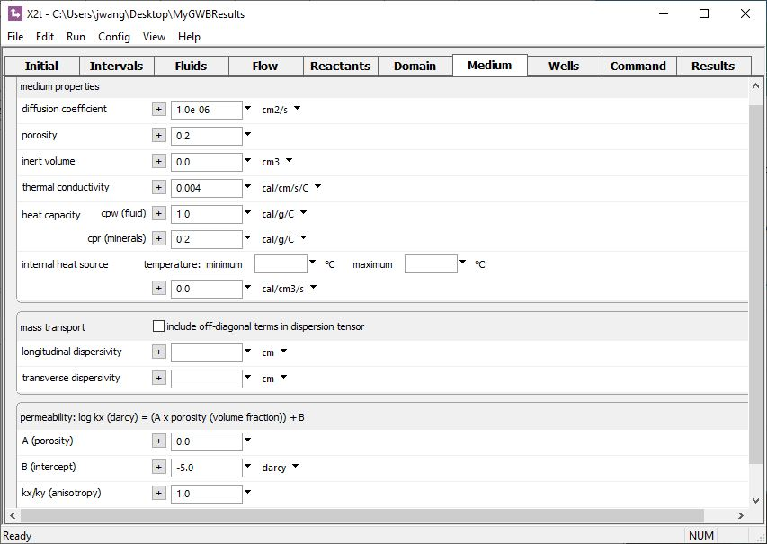
You can set a value for the permeability directly
log k_{x} = (A x Φ) + B
= (0 x 0.2) − 5 = −5
k_{x} = 1e-5 darcys
A set to 0

Slide 5

You can set permeability as a function of porosity
You can set the initial value forΦ (porosity) at each node.
log k_{x} = (A x Φ) + B
= (10 x 0.2) − 5 = −3
k_{x} = 1e-3 darcys

Slide 6
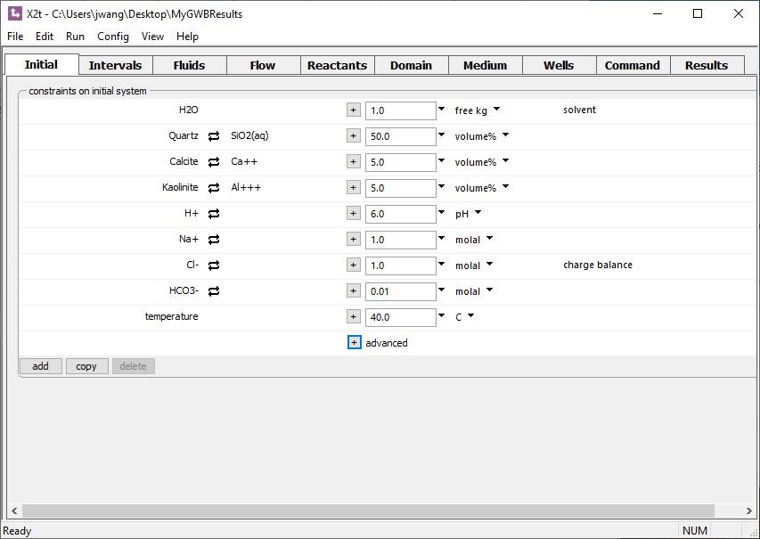
You set the quantity of minerals on the Initial or Reactants pane.
Kaolinite initially occupies 5% of the porous media
(X₁ = 0.05).

Slide 7
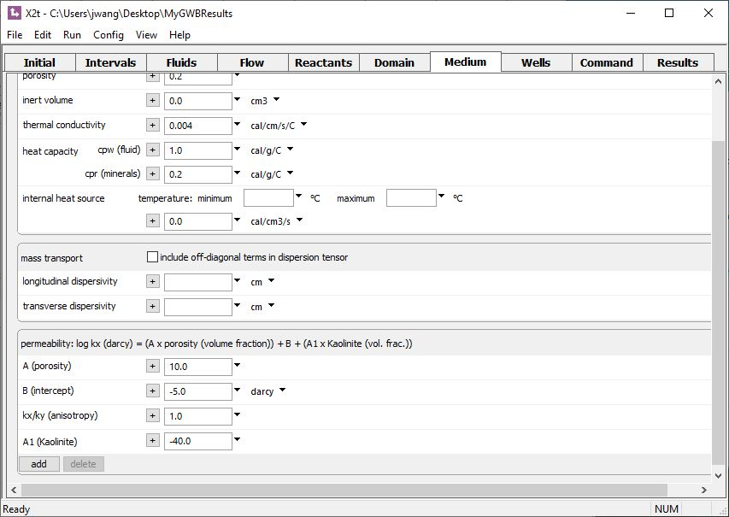
You can set permeability as a function of porosity and the volume of one or more minerals.
Kaolinite decreases the permeability of the porous media.
log k_{x} = (A x Φ) + B + (A₁ x X₁)
= (10 x 0.2) − 5 + (−40 x 0.05) = −5
k_{x} = 1e-5 darcys
add → Kaolinite

Slide 8
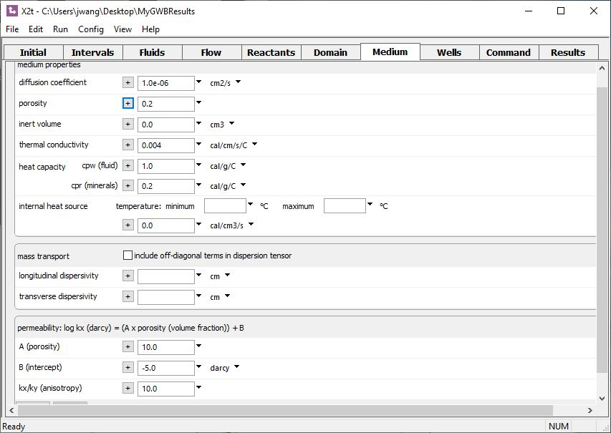
In X2t, you can set the anisotropy of the medium.
The medium is 10 times more permeable along the x-direction than along y.

