Slide 2
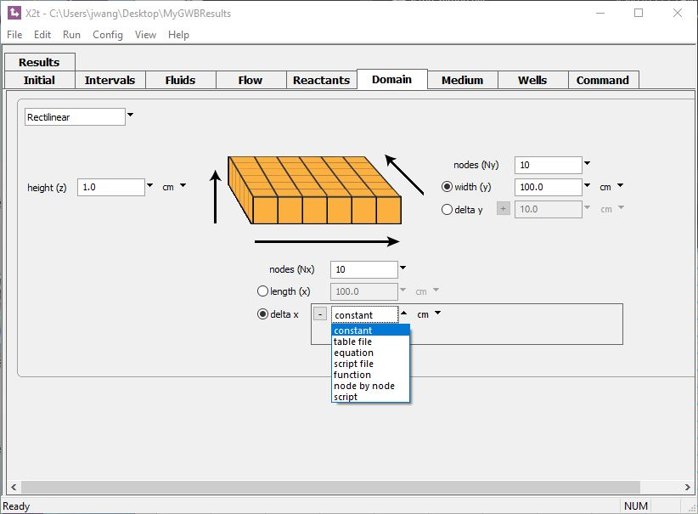
You control discretization on the Domain pane.
Set the number of nodes along x-axis, Nx, and the spacing of each block, ∆x.
Repeat for the y axis.
You can import a table file or supply ∆x node by node. Or, write an equation, script, or function to describe grid spacing.

Slide 3

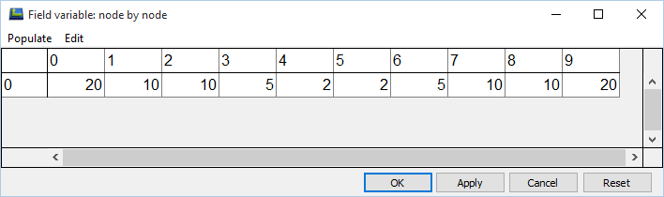
Enter values into a node-by-node editor.
Click Edit…
Set the length of each nodal block along x

Slide 4
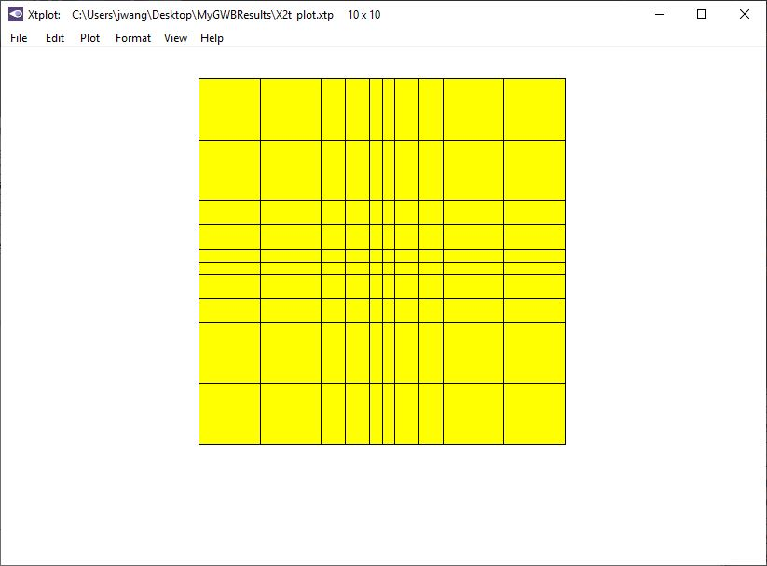
The irregular grid provides greatest resolution in the center of the domain.

Slide 5
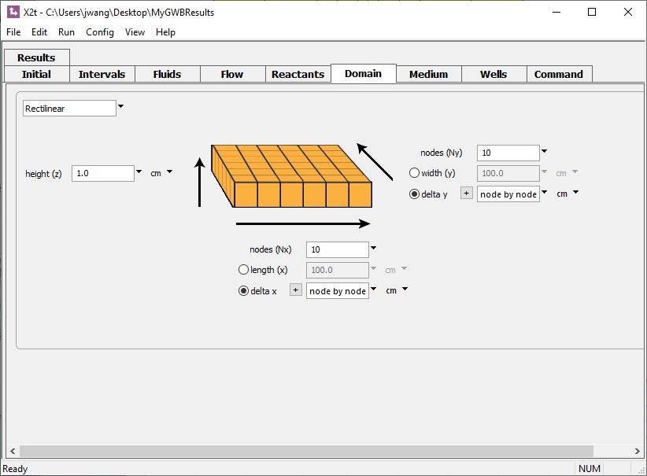
Type in a simple expression.

Slide 6
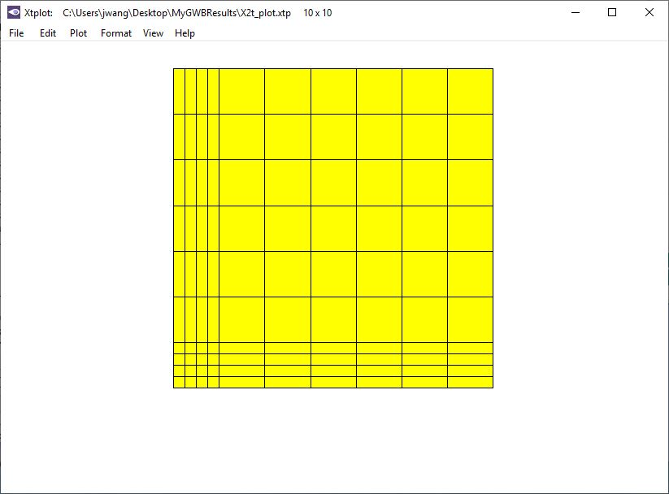
The irregular grid provides greatest resolution in the lower left corner of the domain.
For details on setting field variables, see “Heterogeneity” in the GWB Reactive Transport Modeling Guide.

