Slide 2
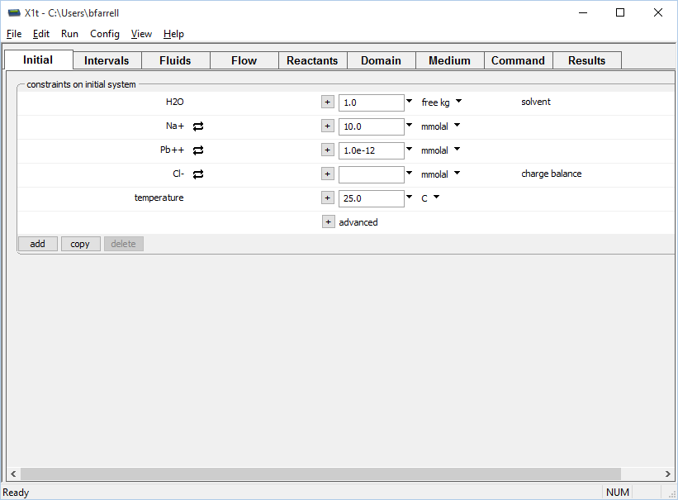
Specify starting fluid composition on the Initial pane.
Clean water

Slide 3
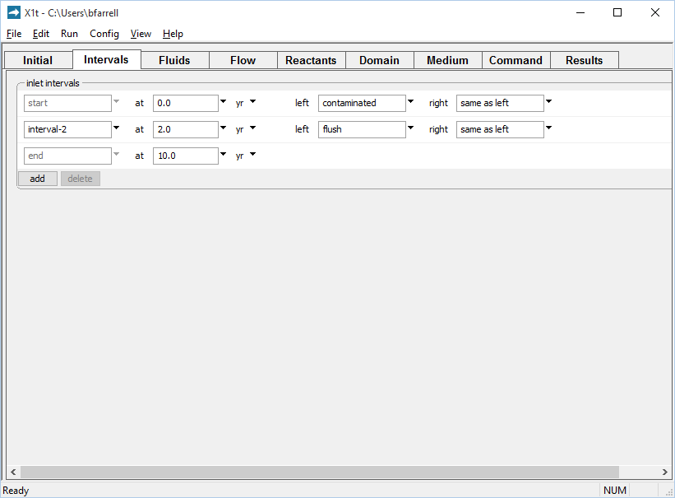
Define the reaction intervals. Specify what fluids flow into the domain, and when.
Inlet fluid “contaminated” enters the domain from t = 0 to 2 years
Inlet fluid “flush” enters the domain from t = 2 to 10 years
Click to add a new reaction interval
You can add any number of reaction intervals.

Slide 4
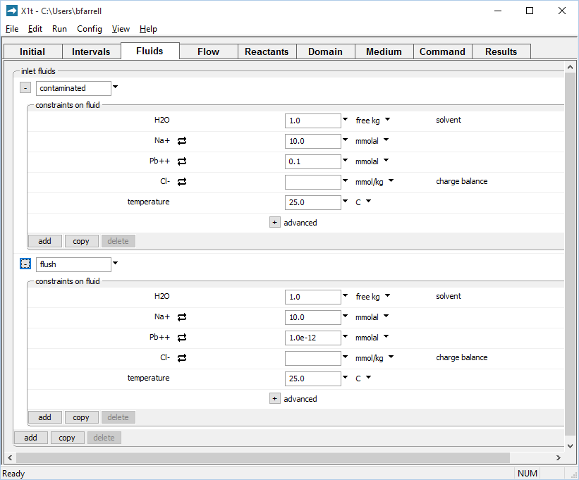
You can define any number of unique fluid chemistries on the Fluids pane
Inlet fluid named “contaminated” carries Pb⁺⁺ pulse into the domain
Clean rinse water: negligible Pb⁺⁺ in the “flush” inlet fluid
Click to add a new fluid

Slide 5
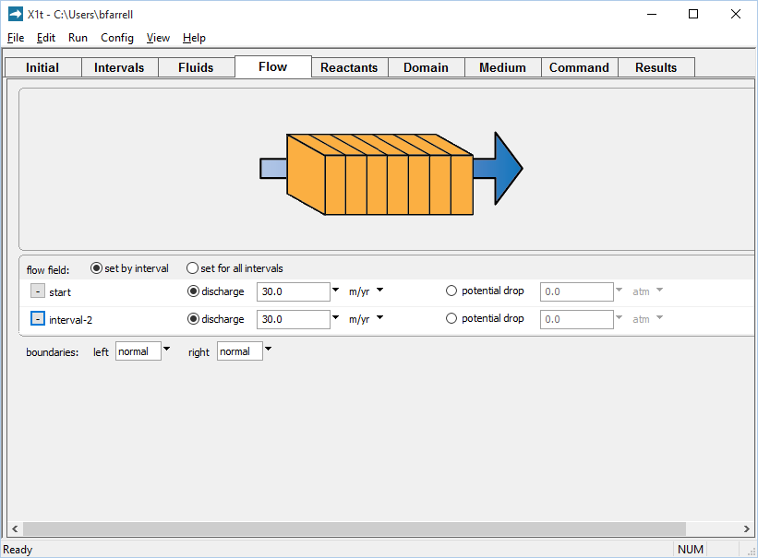
Set the flow field for each reaction interval on the Flow pane.
Set flowrate for each reaction interval individually...
... or set one flowrate for all intervals
Run → Go
traces the model

Slide 6
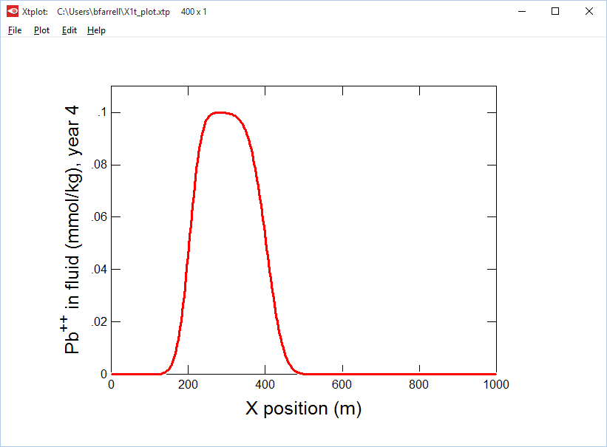
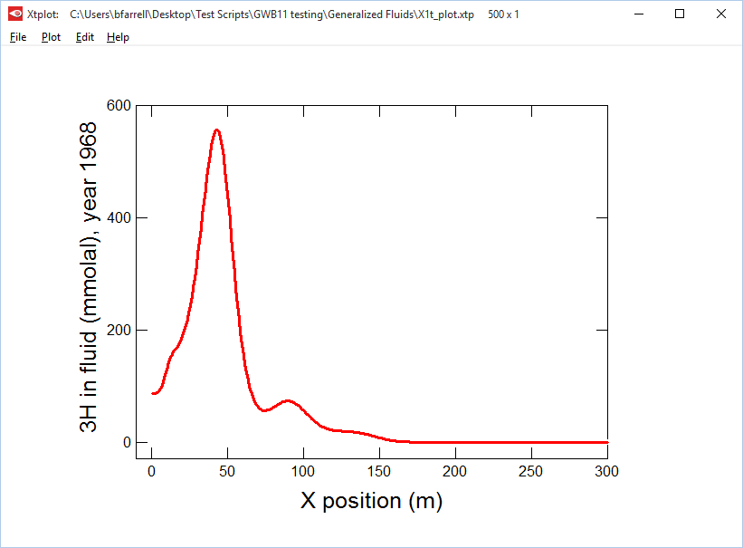
Pb⁺⁺ contaminated water enters domain for two years then is flushed with clean water.
New: For irregular contaminant sources, use any number of boundary fluids and reaction intervals.

Slide 7
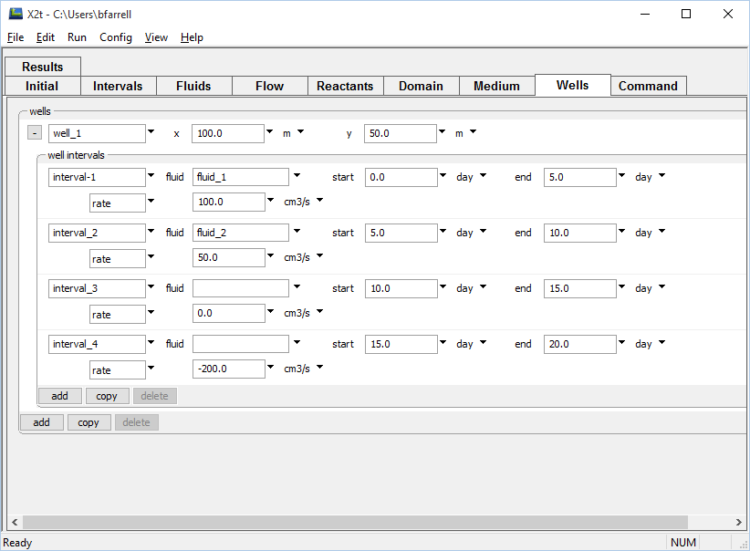
Wells in X2t can have a different pumping rate and fluid chemistry for each well interval.
XY position of well
Positive rate indicates injection
Choose from defined fluids
No pumping
Negative rate indicates extraction

