Slide 2
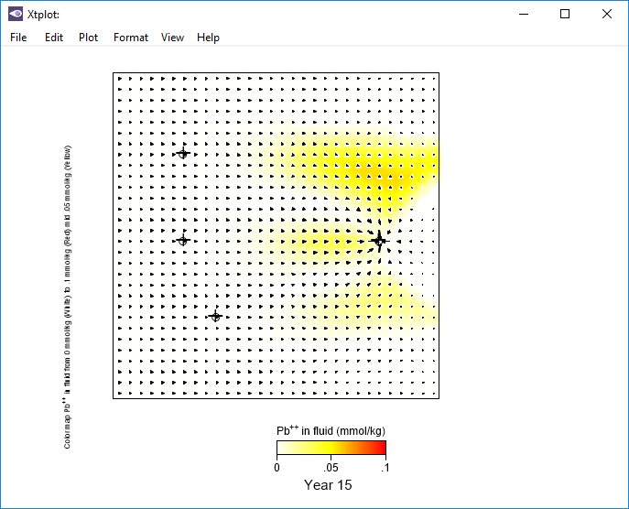
Map View plot shows locations of three point sources of heavy metals and an extraction well.
Heavy metal sources (leak1, leak2, leak3)
Extraction well (extract)
Change the plot type by going to Plot → XY Plot…

Slide 3
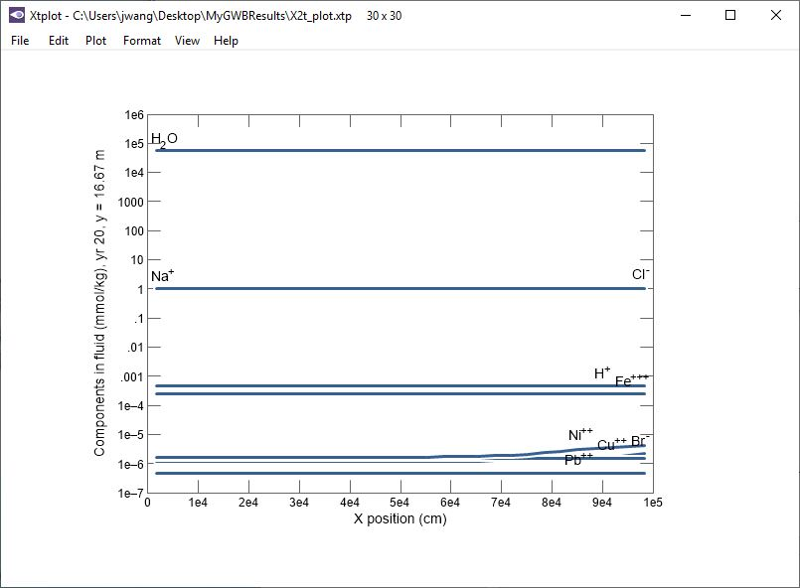
An XY Plot can display the breakthrough curve at any location, such as a monitoring or extraction well.
Double-click on the center of the plot to bring up the XY Plot configuration dialog

Slide 4
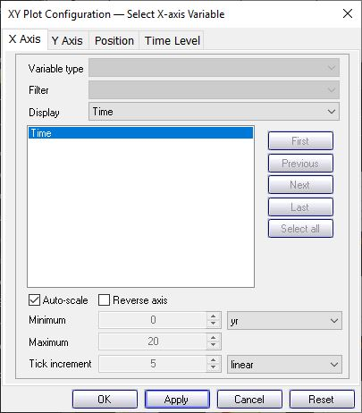
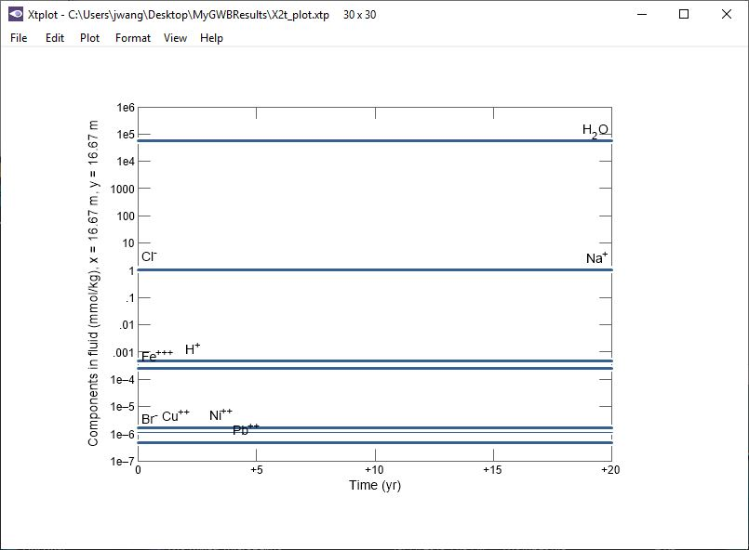
To plot a breakthrough curve, plot time along the X Axis.
Display time
Choose units
Plot vs. time.
Next, choose variables

Slide 5
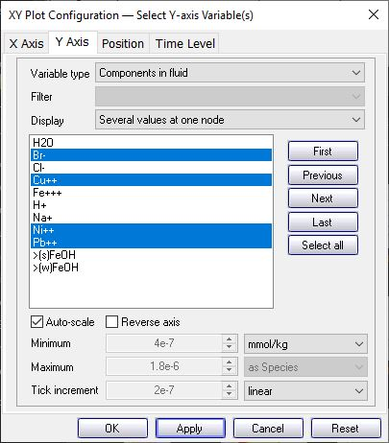
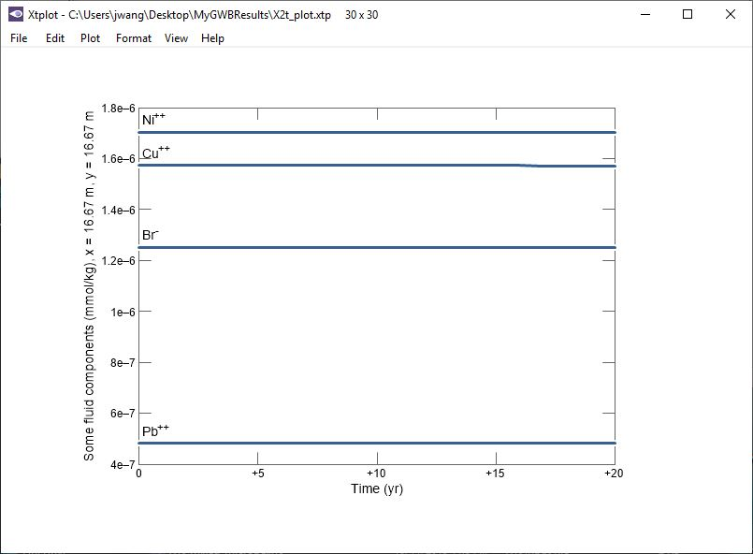
Choose “Components in fluid” for concentration of thermodynamic components
Plot concentration of desired components on the Y Axis.
Plot several variables on the Y axis
Select nonreactive tracer and three sorbing metals
Chosen variables vs. time. Next, choose position

Slide 6
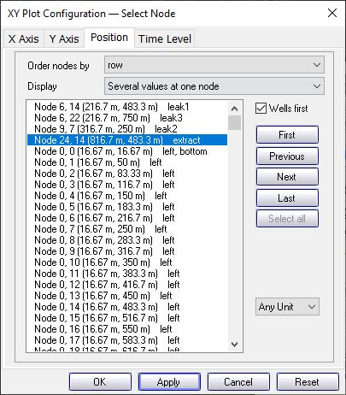
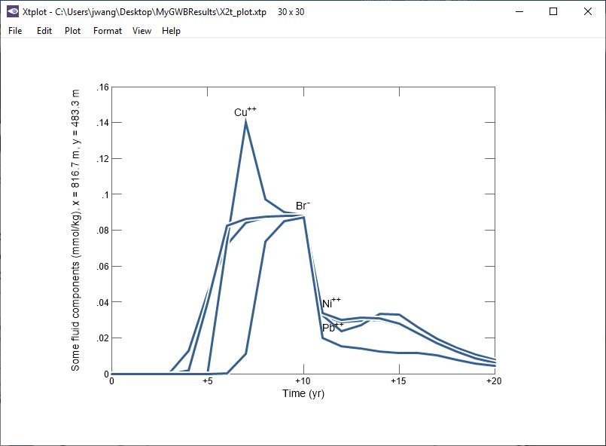
Move nodes with wells to the top of the list
Choose position from which fluid will be produced, such as an extraction well.
Choose the extraction well
Chosen variables vs. time at specified position

Slide 7
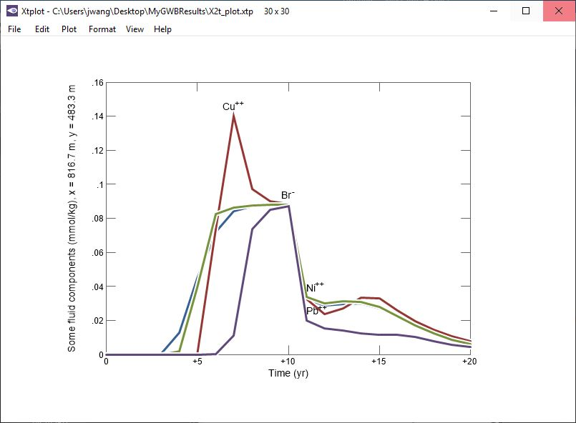
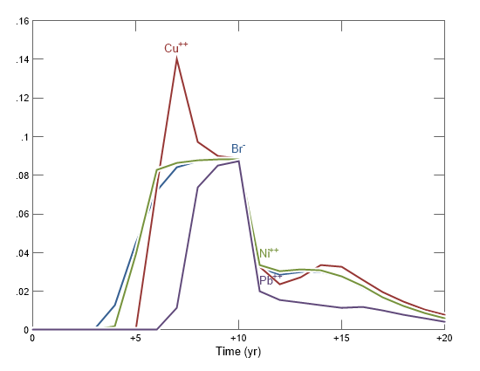
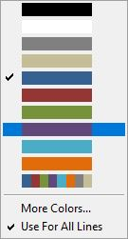
You can match line and label colors to distinguish between analytes more easily.
Right-click on a label → Color → Use Line Color
Right-click on a line → Color →
Transport of heavy metals retarded relative to Br⁻ tracer

