Slide 2
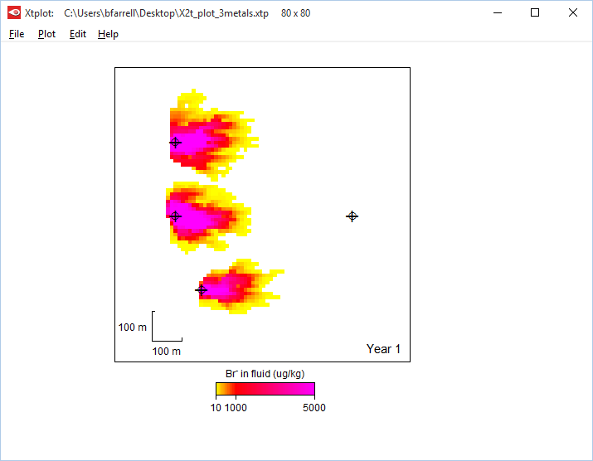
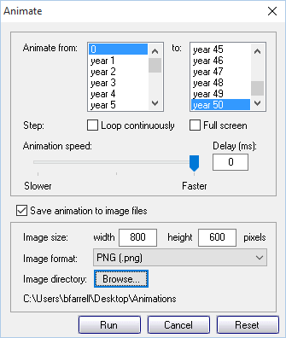
Choose PNG, JPEG, TIFF, or Bitmap
Configure your animation in Xtplot, then check “Save animation to image files” and click Run.
Save images here

Slide 3
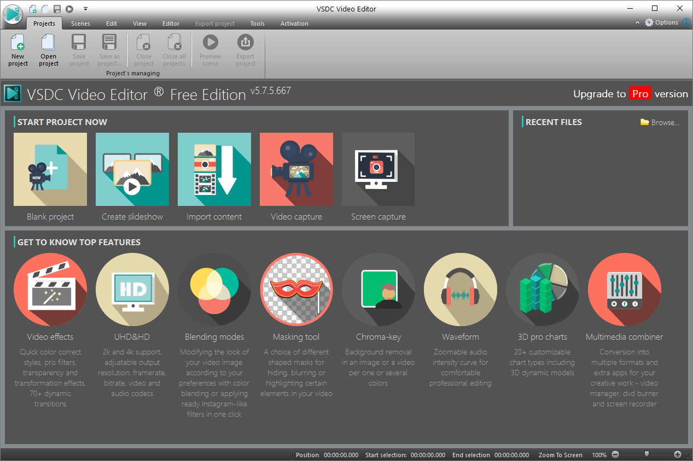
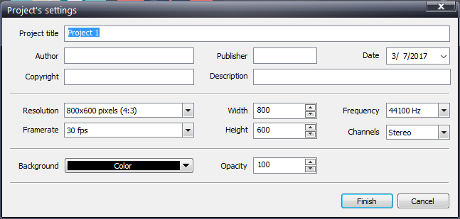
Start VSDC, a free video editor, and click Create slideshow
Give your project a title, then click Finish to launch File’s sequence wizard.

Slide 4
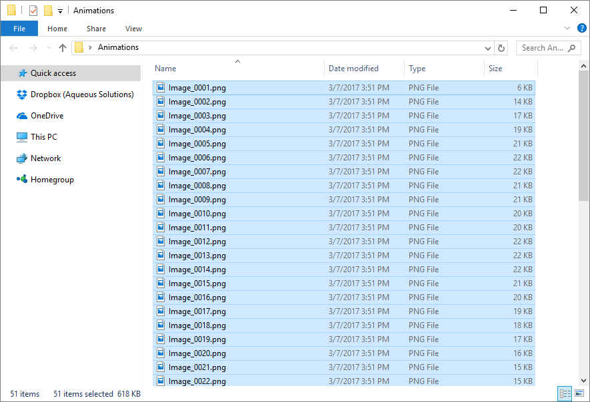
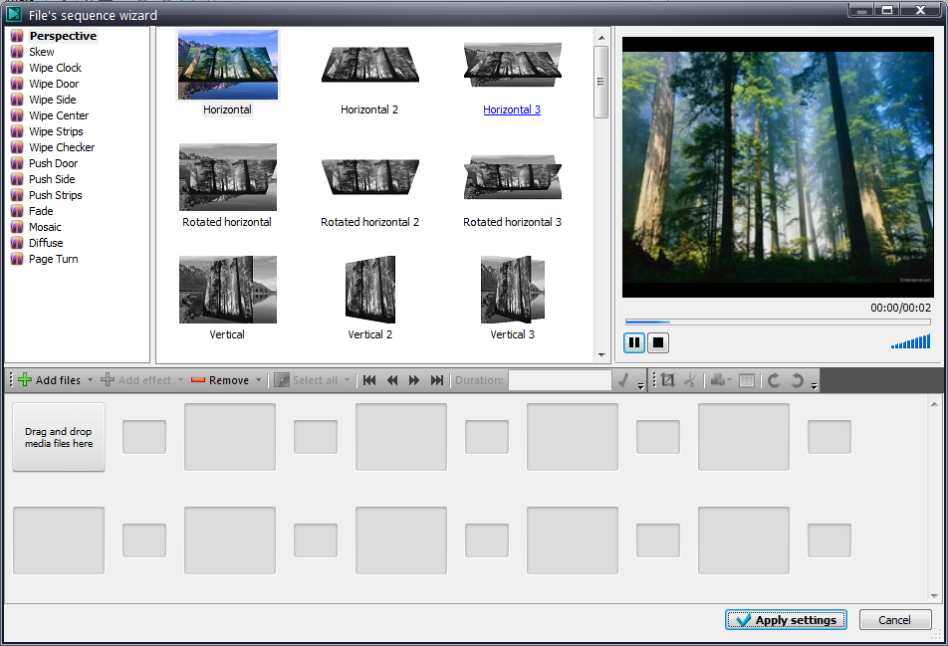
Drag your image files into VSDC’s sequence wizard.

Slide 5
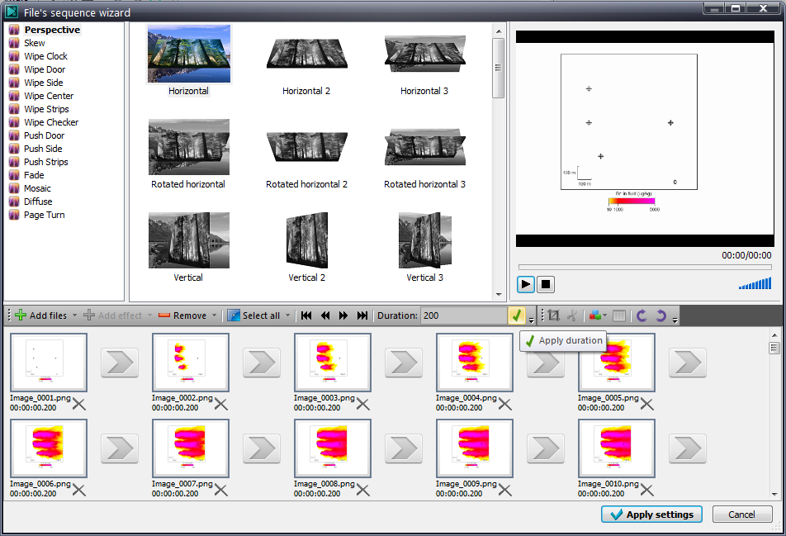
Select all frames and set the duration (in milliseconds) for each, then hit to apply.

Slide 6
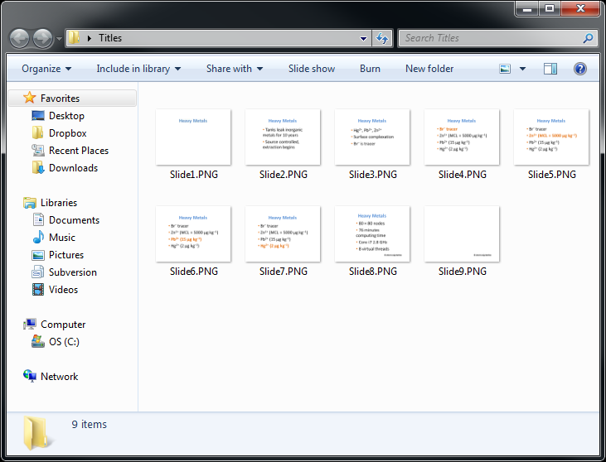
Create Title, Intro, Section slides in PowerPoint, then save as image files.

Slide 7
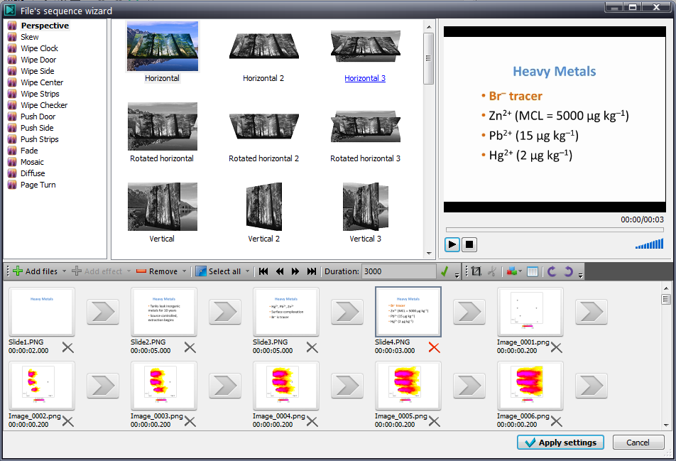
Drag Title and other slides into VSDC (drag to reorder), set their durations, then hit to apply.
Hit Apply settings to continue.

Slide 8
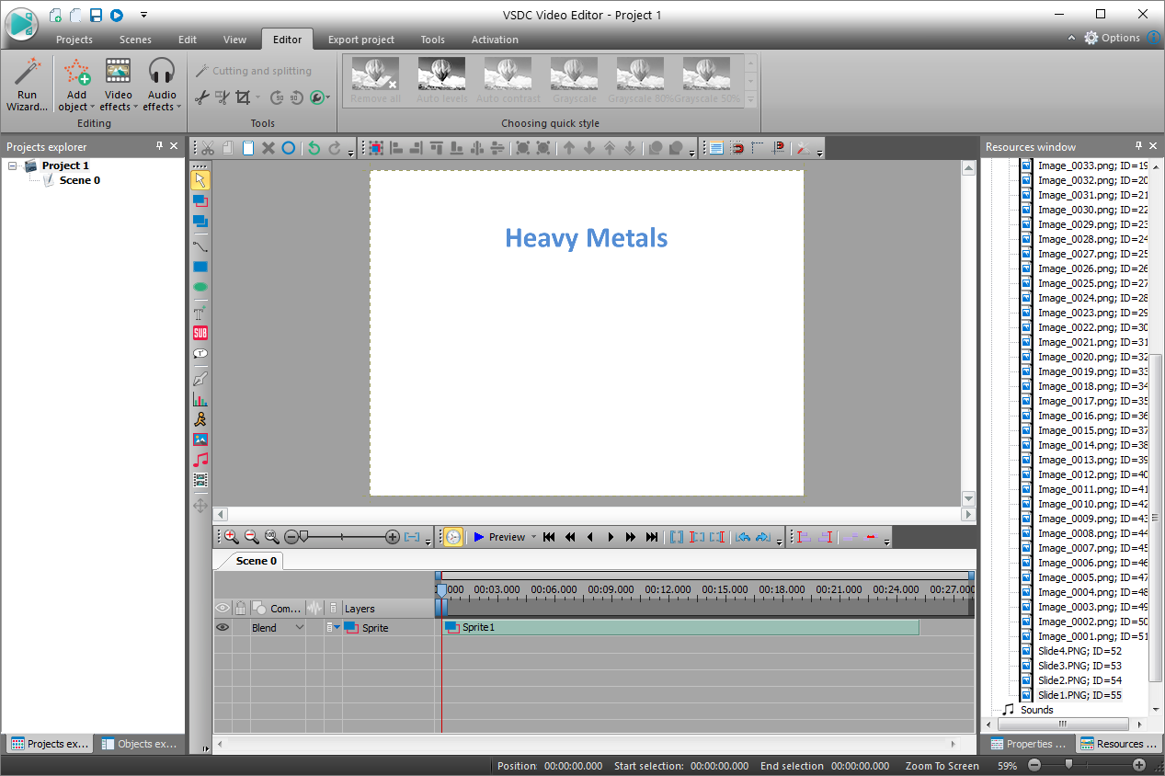
Click Export project to save video clip.

Slide 9
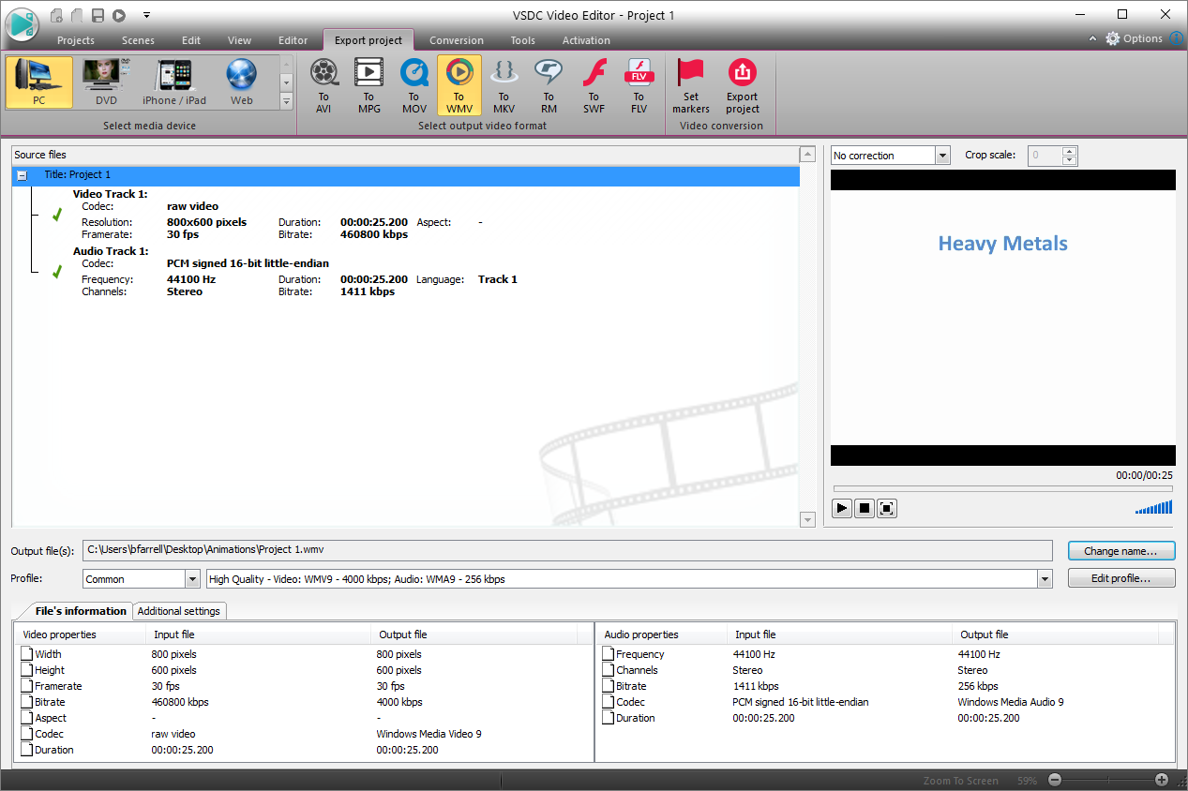
Save to PC, choose video format, set name and location of output file, then click Export project

Slide 10
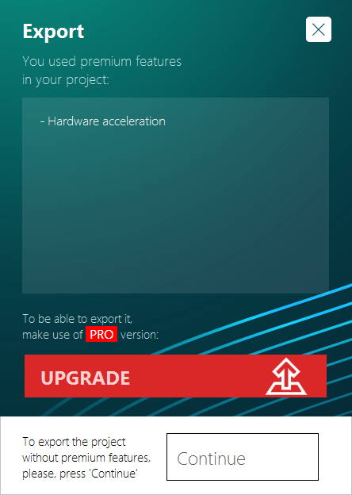
If using free version, hit Continue to finish

Slide 11
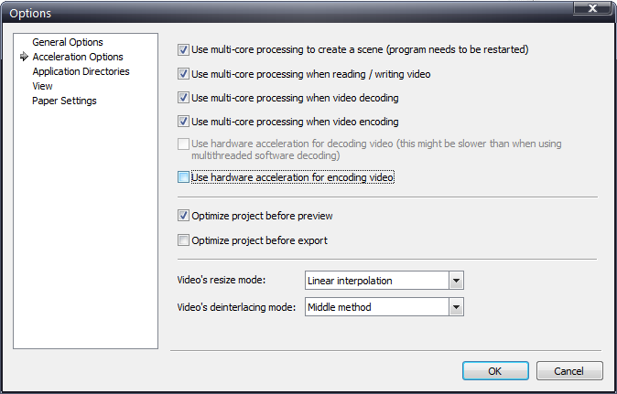
To avoid this message with free version, go to Options → Accelerator Options → uncheck “Use hardware acceleration for encoding video”

Slide 12
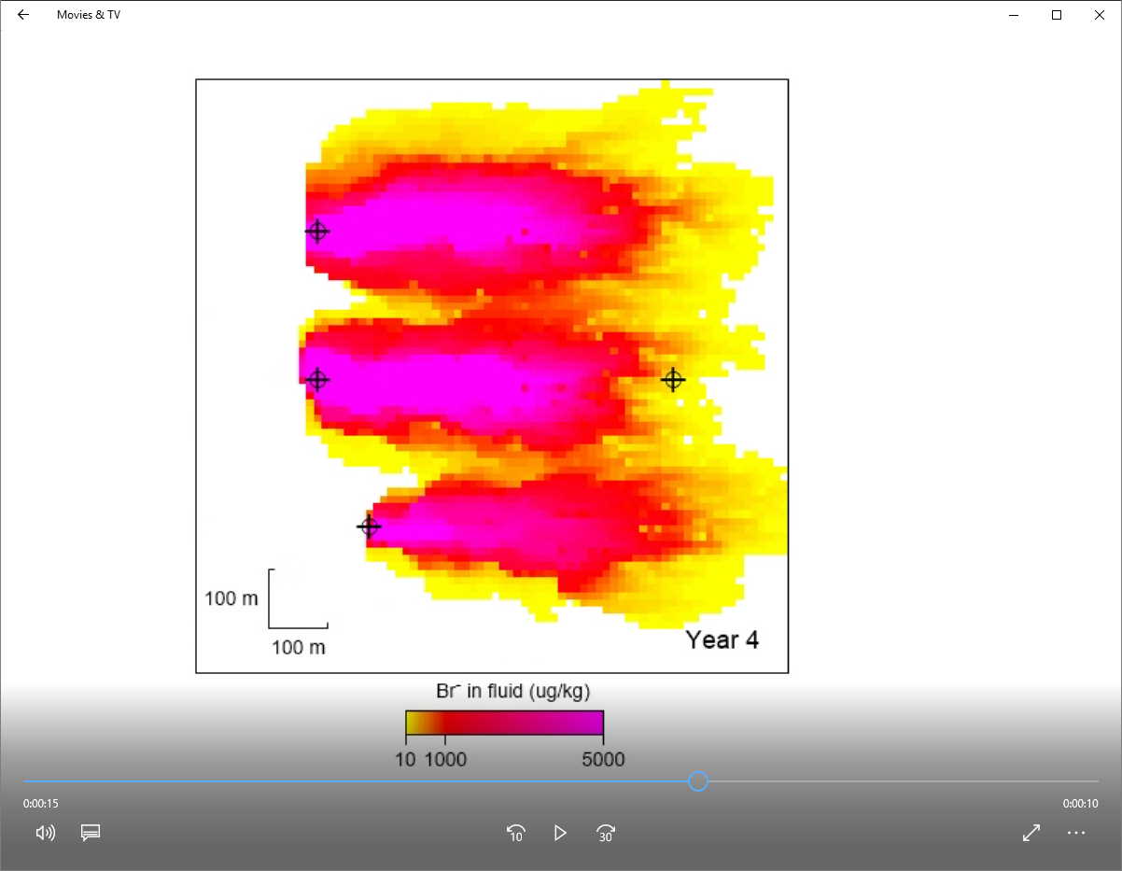
Click “Play” to view your movie.

