Slide 2
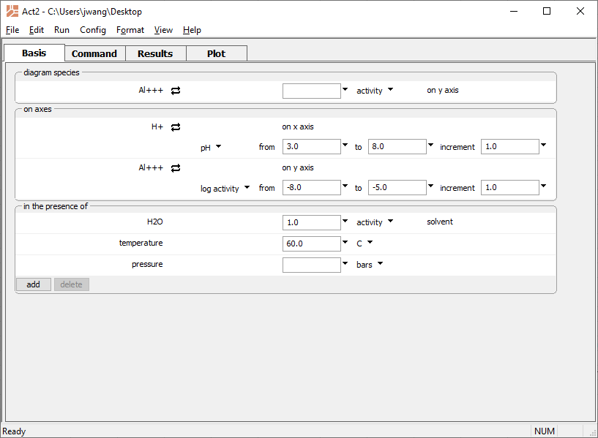
Choose pH for the x axis
Set the main species as the
y axis variable
Set temperature
Run → Go
draws the diagram

Slide 3
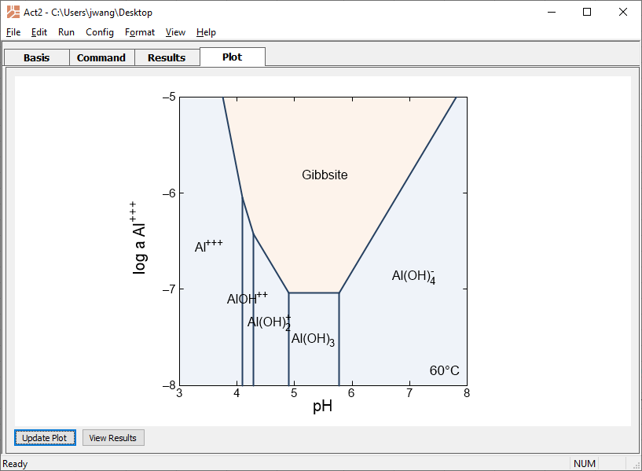
Gibbsite is very soluble at low and high pH
You can return to the Basis pane to modify your diagrams if necessary

Slide 4
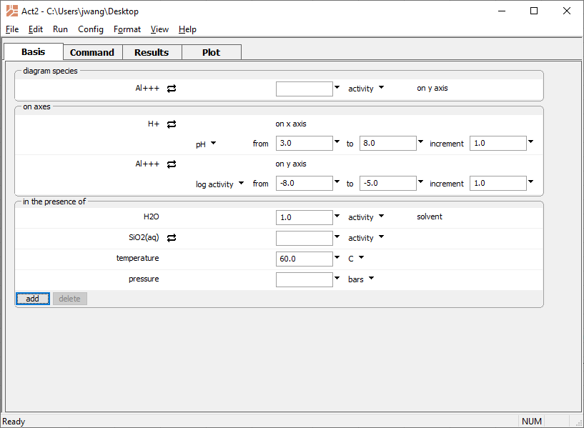
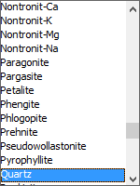
You can consider a system in equilibrium with Quartz
Run → Go
updates the diagram

Slide 5
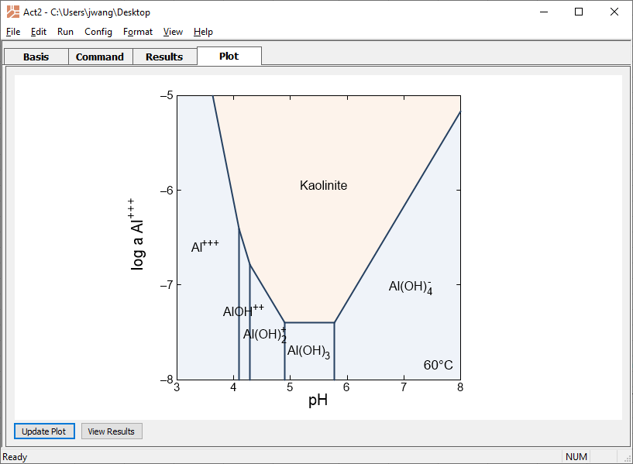
Kaolinite solubility

