Slide 1
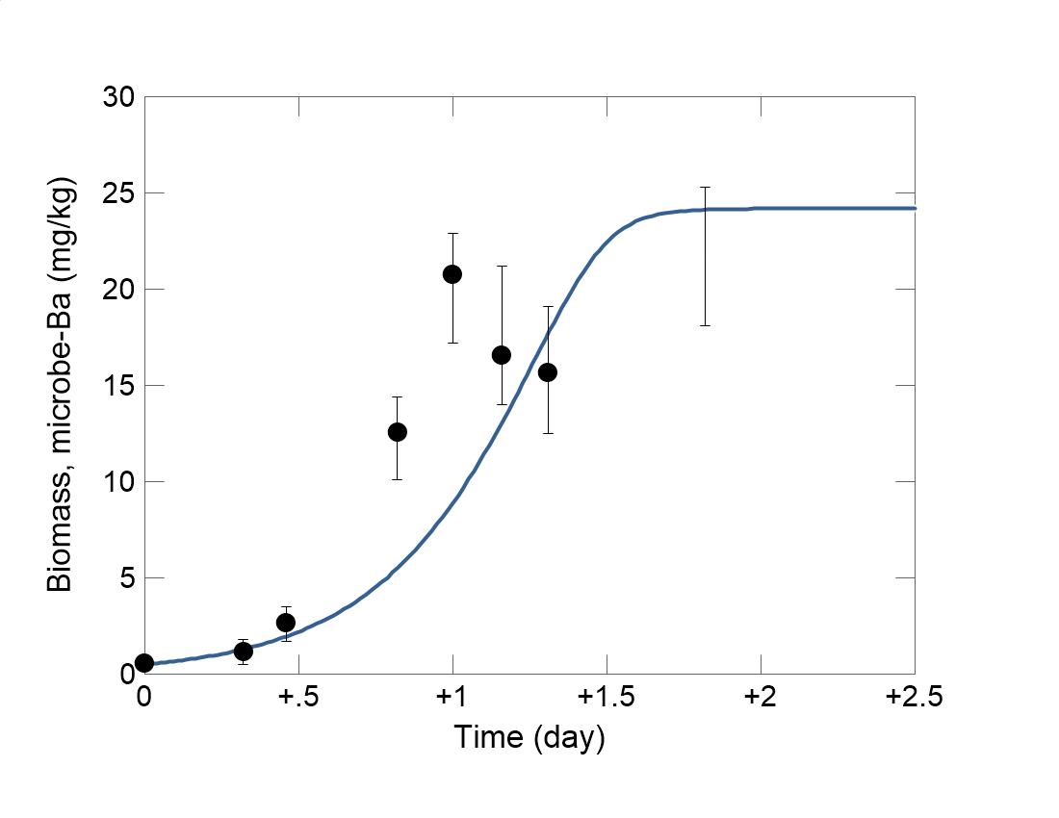

Slide 2
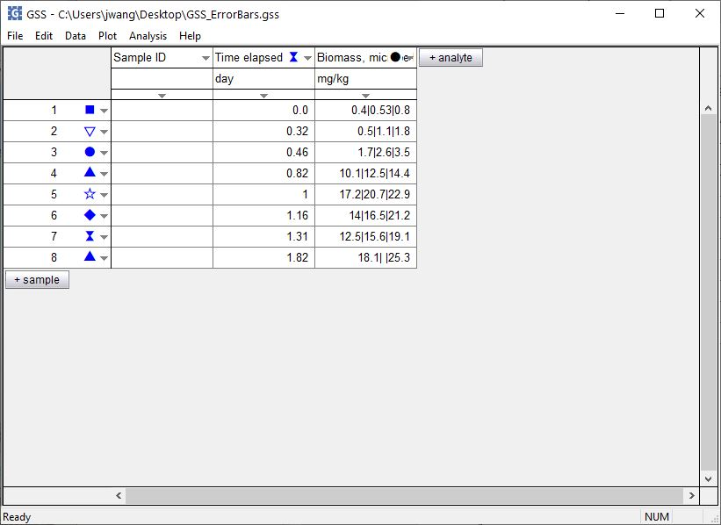
You can set error bars for the data in your GSS spreadsheets.
Enter a triplet of values separated by vertical bars.
A data point at 16.5 overlays an error bar extending from 14 to 21.2.
If you don’t enter a value between the vertical bars, you’ll plot the error bar by itself.

Slide 3
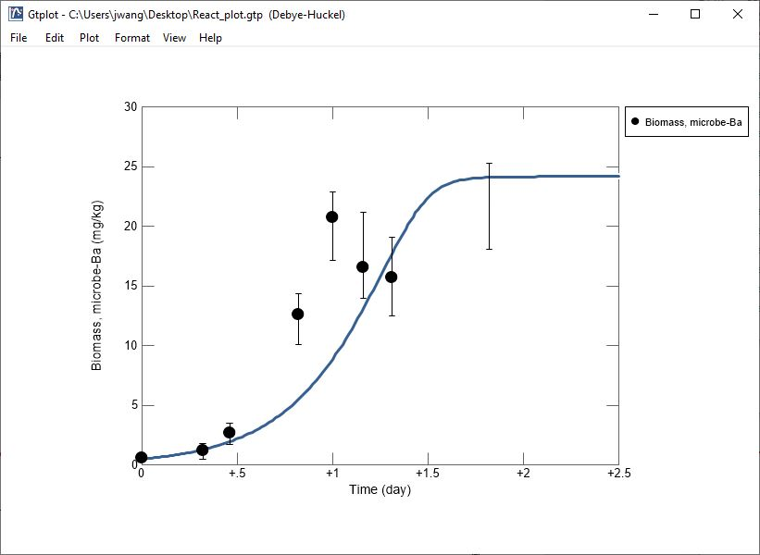
A data point at 16.5 overlays an error bar extending from 14 to 21.2.
Error bar alone.

