Slide 1
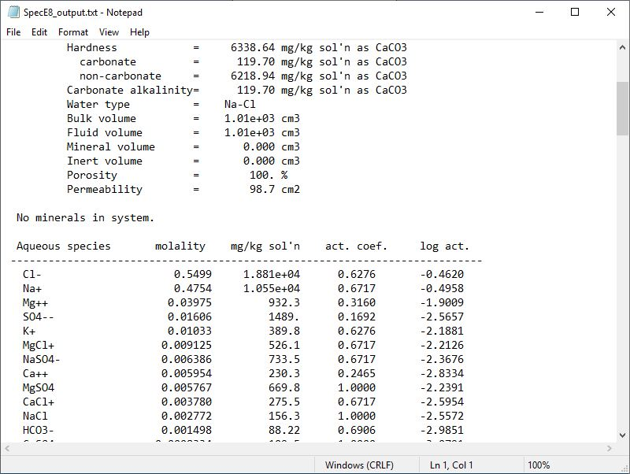
Concentrations and activities

Slide 2
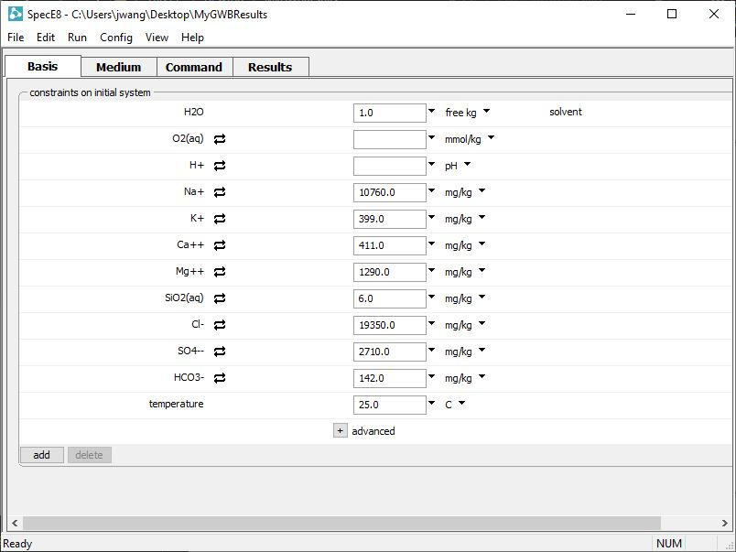
Enter your fluid composition on the Basis pane
Set dissolved concentrations in units of your choice
Set temperature of your system
Click to add new entries

Slide 3
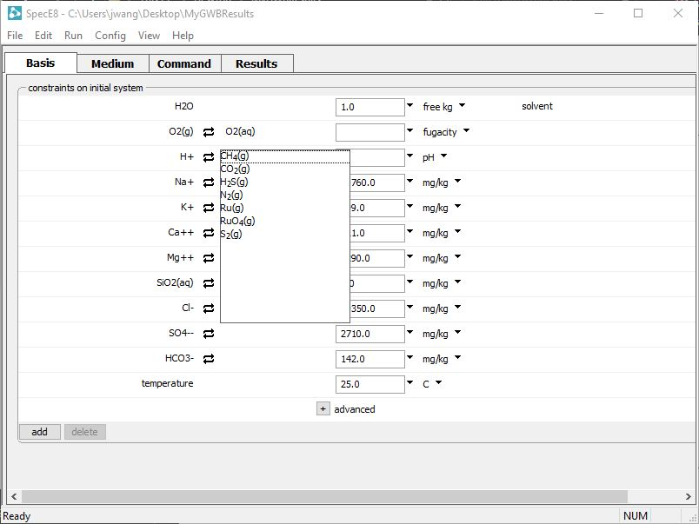
You can swap gases of known partial pressure or fugacity into the Basis
O₂(g) swapped for O₂(aq)
Swap CO₂(g) for H⁺

Slide 4
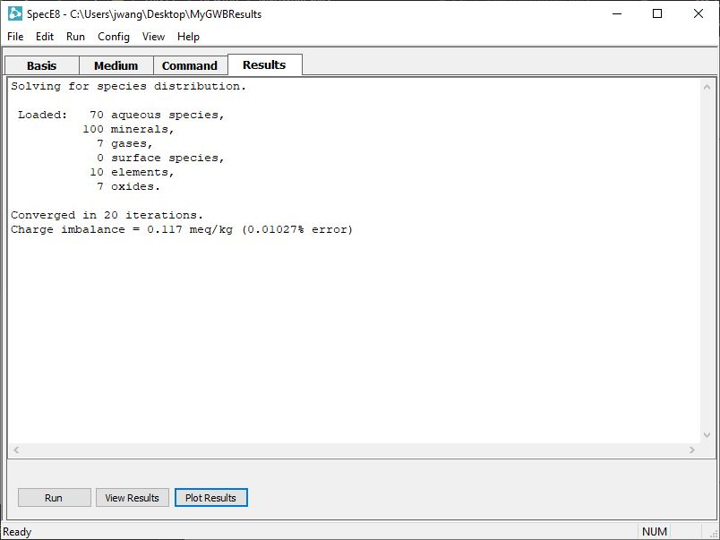
On the Results pane, click Run to execute the calculation.
Open text file
Plot results with Gtplot

Slide 5
“View Results” opens text file
Species listed in order of molal concentration
Activity coefficients
Species activities

Slide 6
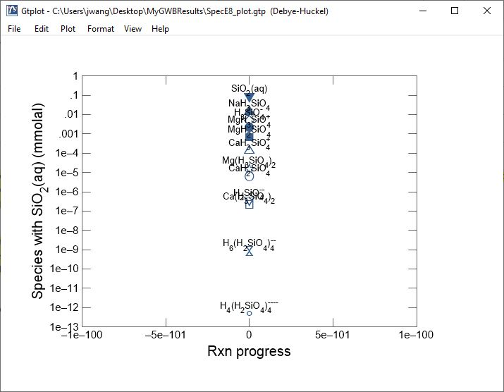
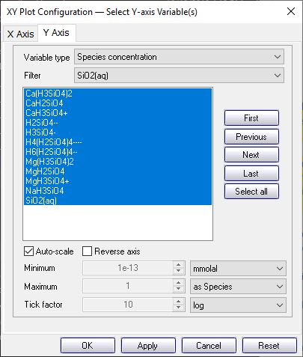
“Plot Results” opens Gtplot
Set Variable type, then choose from the list of variables
Set X and Y axes
Filter the species for display

