Slide 1
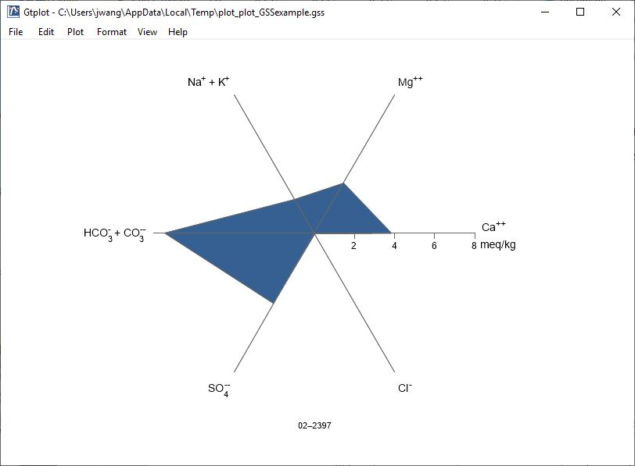
Radial Plots

Slide 2
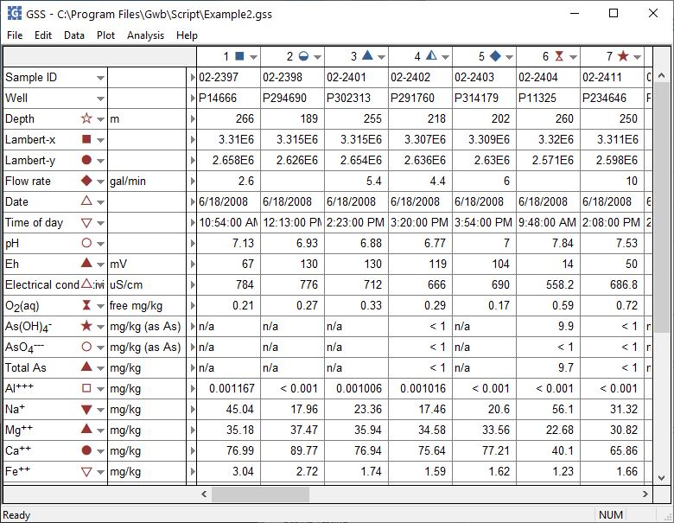
You can launch Gtplot from GSS to create Radial Plots and other specialty plots.
Plot → Radial Plot…

Slide 3
By default, the Radial plot shows major cations and anions in electrical equivalent units.
Right-click on labels or axes to change color, font, size, etc.
Double-click on plot to bring up the Radial Plot configuration dialog.
Double-click outside the plot to open the Quick Toggle… dialog. Toggle sample labels and more.

Slide 4
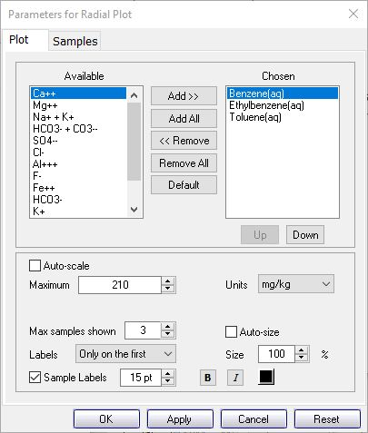
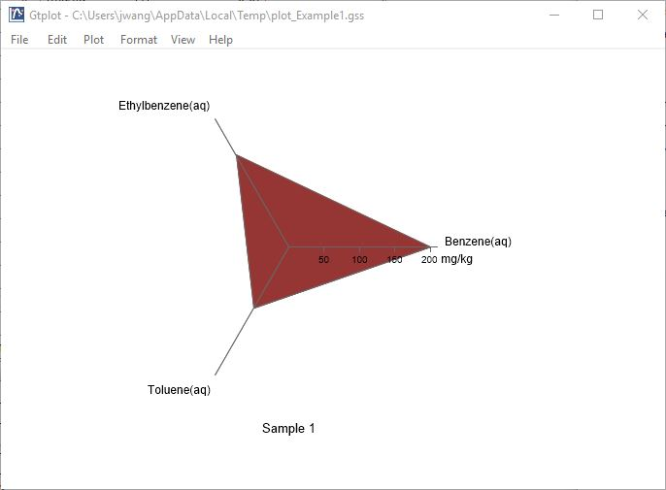
You control details of the Radial Plot from the Plot pane.
You can remove all the default analytes and replace them with others, including uncharged species. Use Up/ Down to reorder.
Use non-electrical equivalent units to plot uncharged species, like organic compounds.
When plotting multiple samples, label axes on first plot, all plots, or no plots.

Slide 5
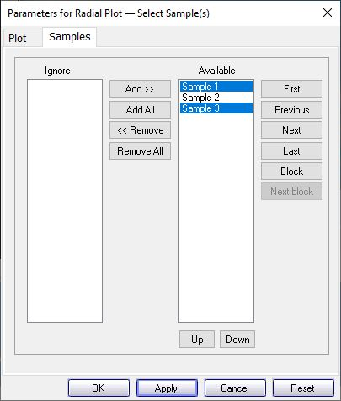
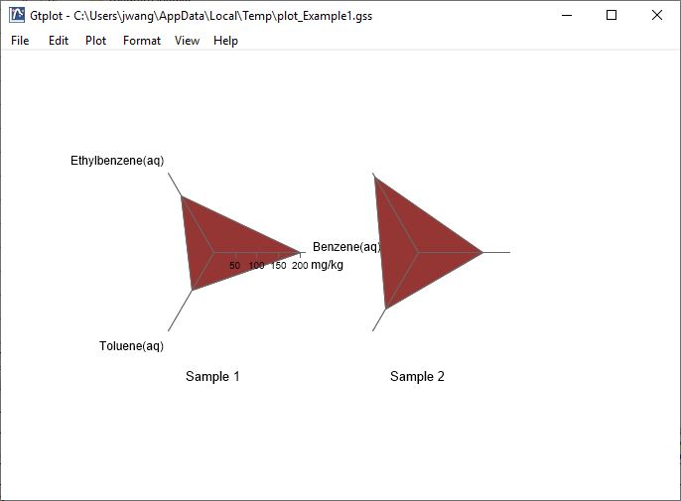
You control which samples are displayed from the Samples pane.
You can cycle through samples one at a time…
Select the samples to plot.
Use Block, Next block to cycle through groups of samples.

