Slide 1
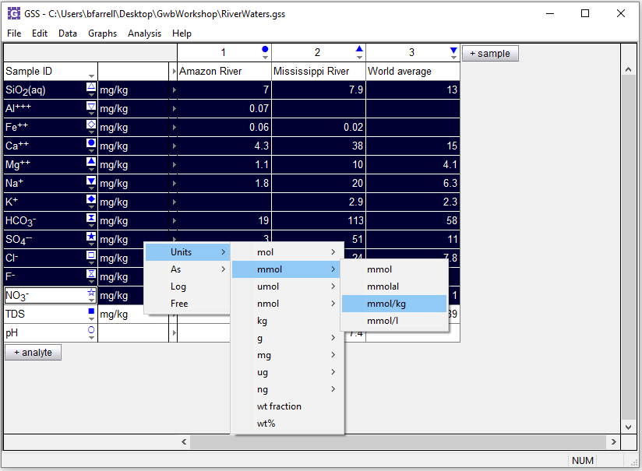
GSS is a spreadsheet for manipulating and plotting geochemical data.
Right-click on unit field to convert units

Slide 2
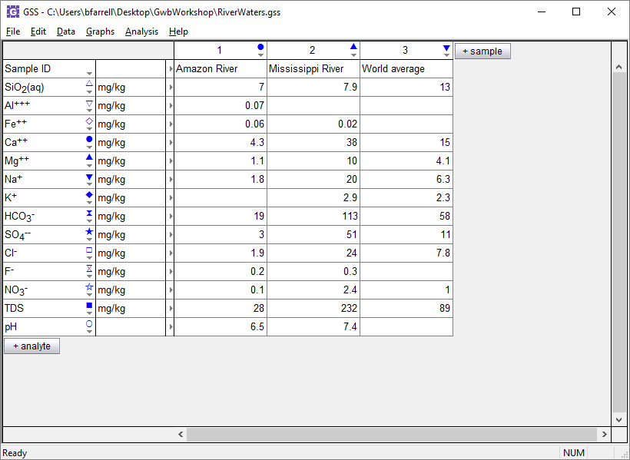
Enter chemical data for one or more samples in GSS, then perform geochemical calculations.
+ analyte → Calculate…

Slide 3
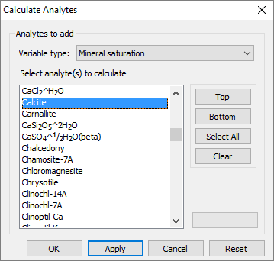
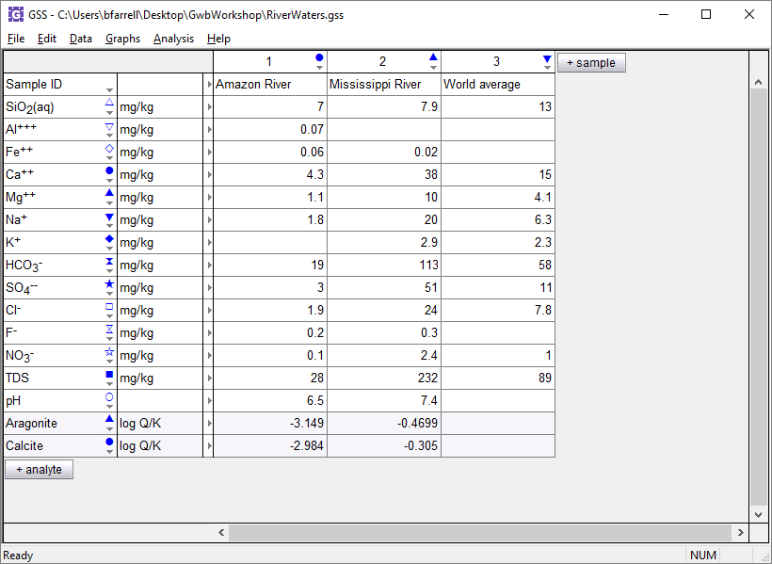
For variable type, choose Mineral saturation
Select a mineral then click Apply
Calculated saturation indices added to spreadsheet

Slide 4
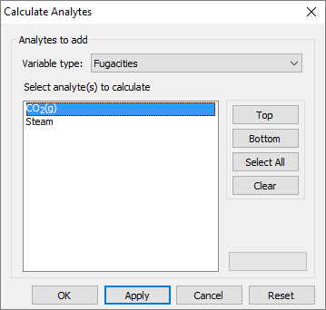
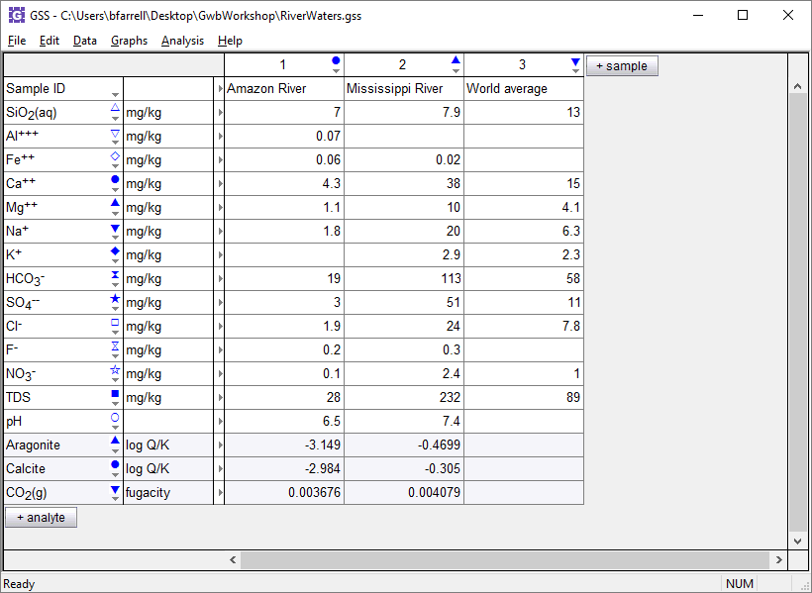
For variable type, choose Fugacities
Select a gas then click Apply
Calculated gas fugacity added to spreadsheet

Slide 5
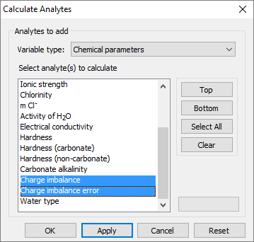
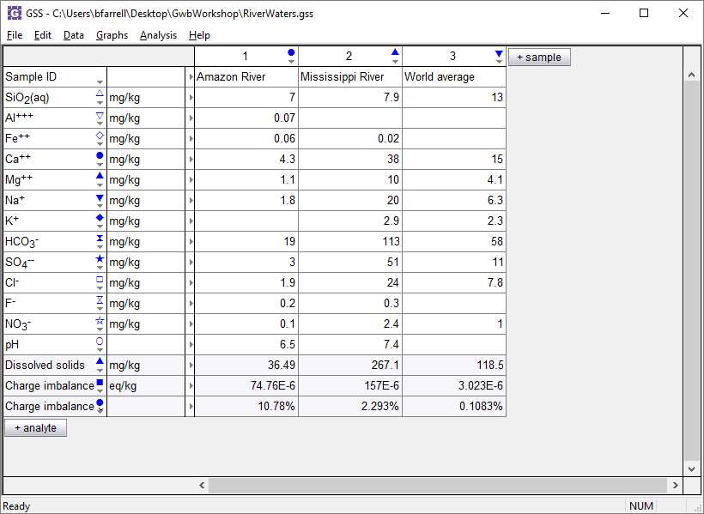
For variable type, choose Chemical parameters
Select analytes then click Apply
Calculated analytes appear below your original data

Slide 6
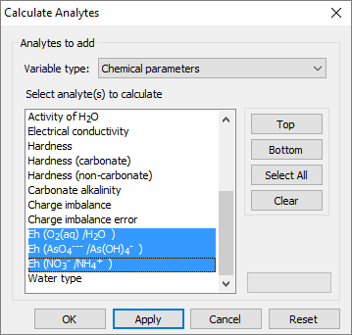
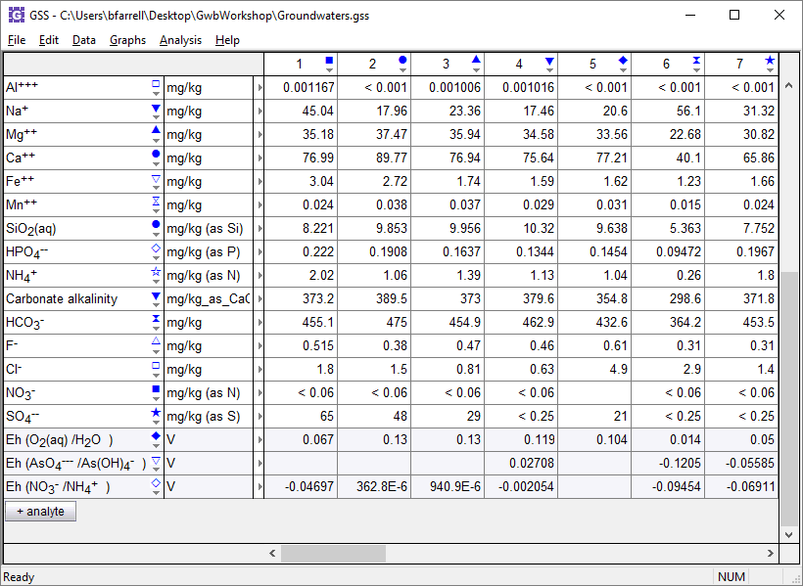
For variable type, choose Chemical parameters
Select one or more parameters, then click Apply
Nernstian Eh is calculated where analyses of elements are provided in multiple oxidation states.

Slide 7
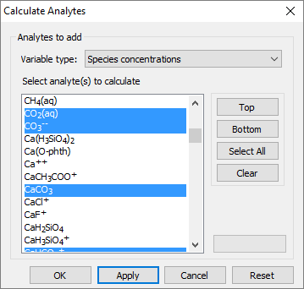
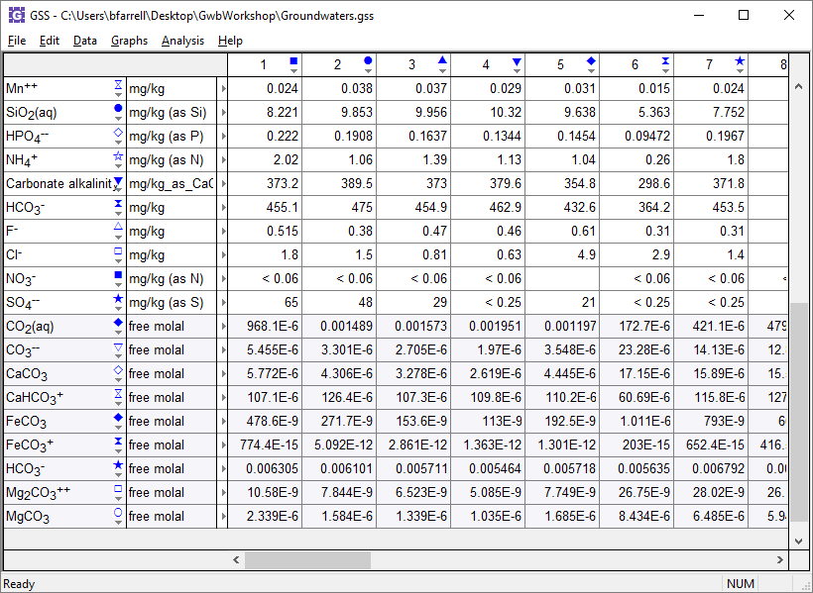
For variable type, choose Species concentrations
You can also calculate species activities or activity coefficients
Select a species, then click Apply
The concentrations of the actual species in solution are reported.

Slide 8
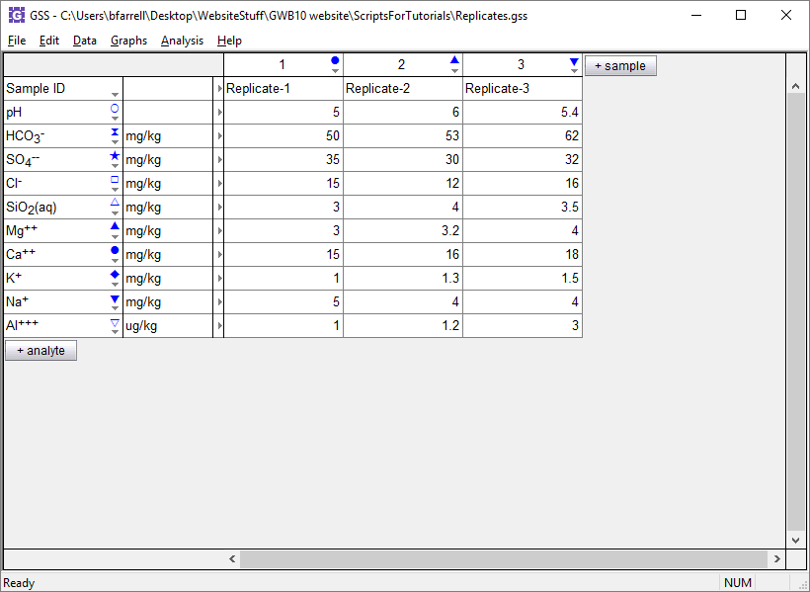
GSS can compare replicate analyses to verify the results agree to within an error tolerance.
Analysis →
Compare Replicates…
Replicate analyses or splits of a single sample

Slide 9
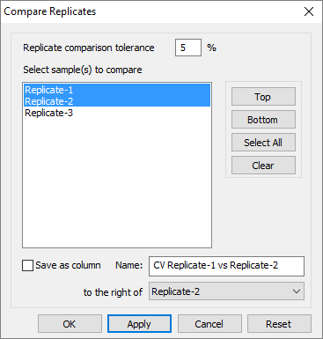
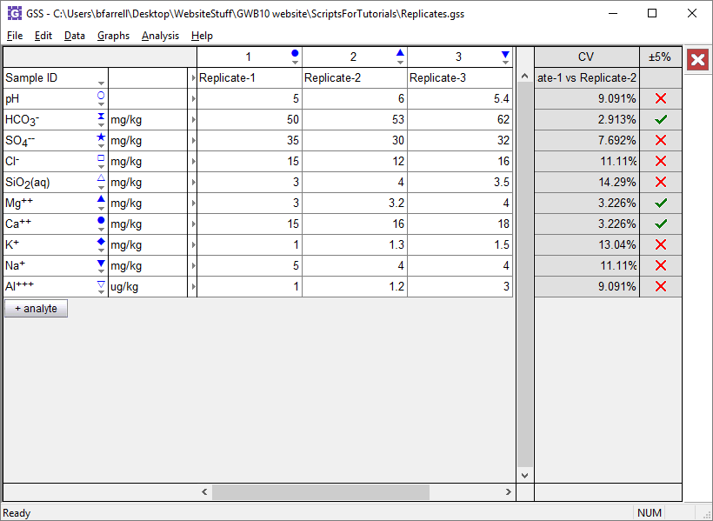
Set an error tolerance
Select samples to compare then click Apply
Check marks indicate an acceptable coefficient of variance between replicates.
X’s appear where the error tolerance is exceeded.

Slide 10
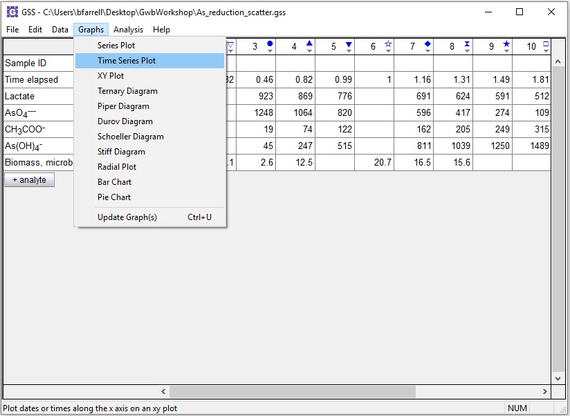
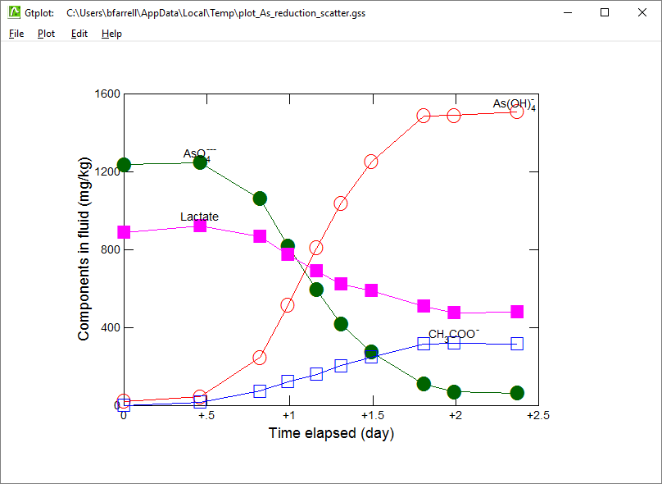
You can display your data in Time Series and XY plots
Graphs → Time Series Plot

Slide 11
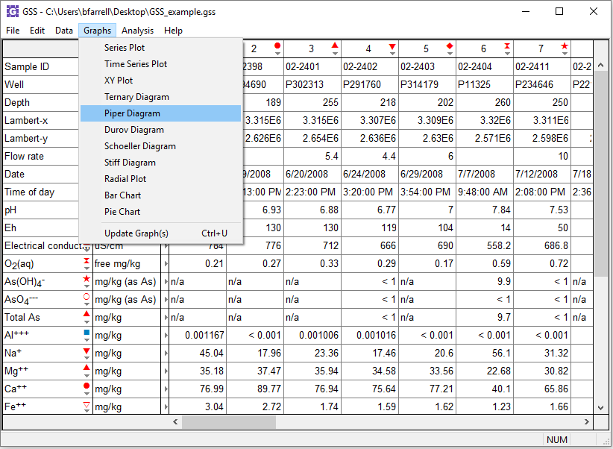
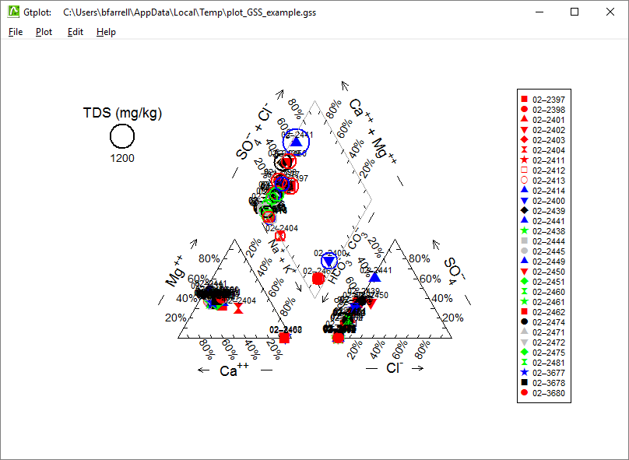
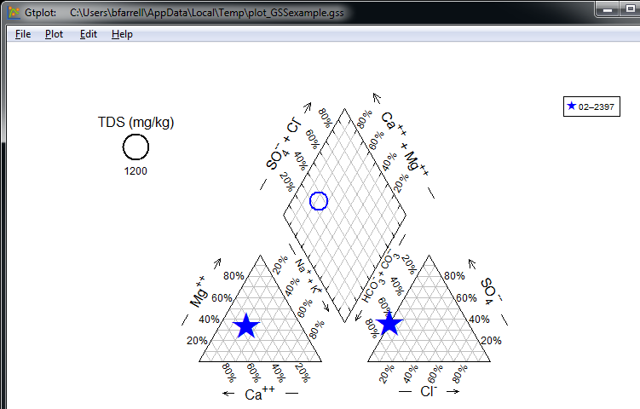
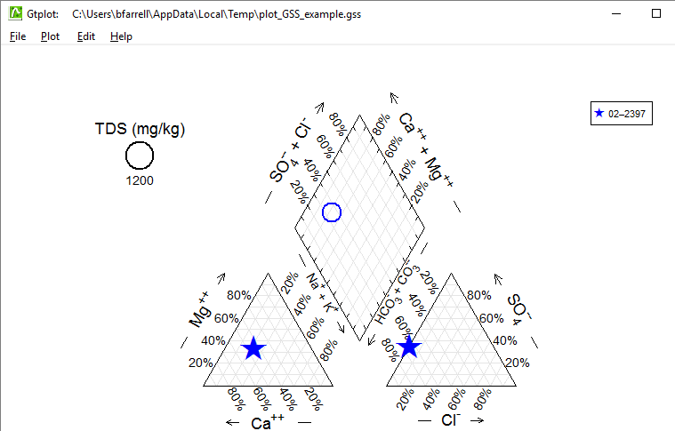
You can choose from a variety of water chemistry plots
Graphs → Piper Diagram
Change color, marker, and size for sample 02-2397.

