Slide 1
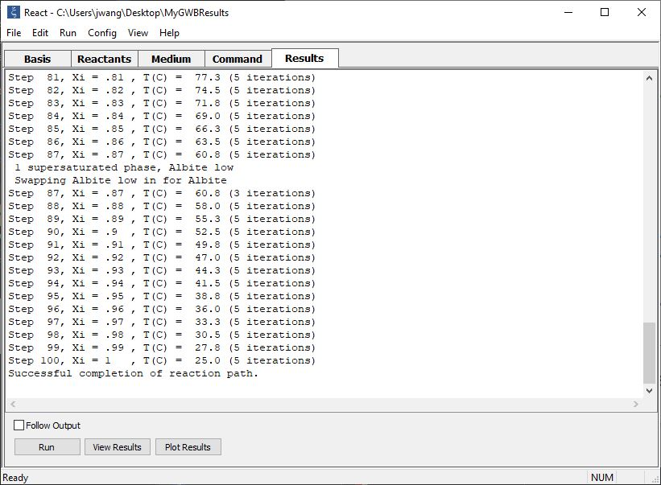
Picking up calculation results

Slide 2
After performing a calculation, React can “pick up” the results and use them for a new calculation.
You can pick up an entire system, or just the fluid or mineral fraction.

Slide 3
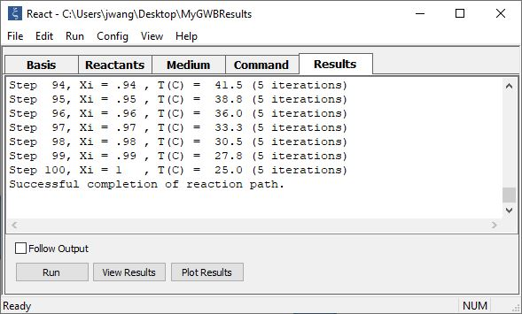
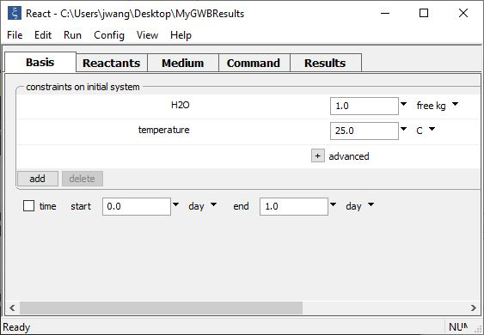
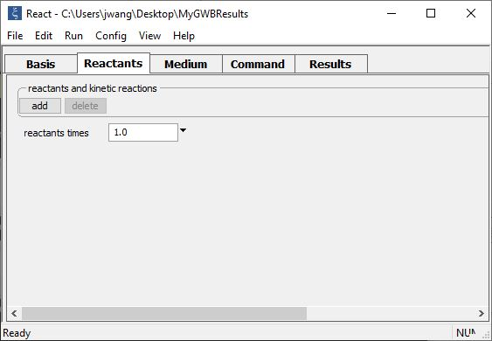
Run → Pickup → …
Choose Pickup → System to use your results as the starting point for a new equilibrium system.
Choose Pickup → Reactants to use your results as a new set of reactants.

Slide 4
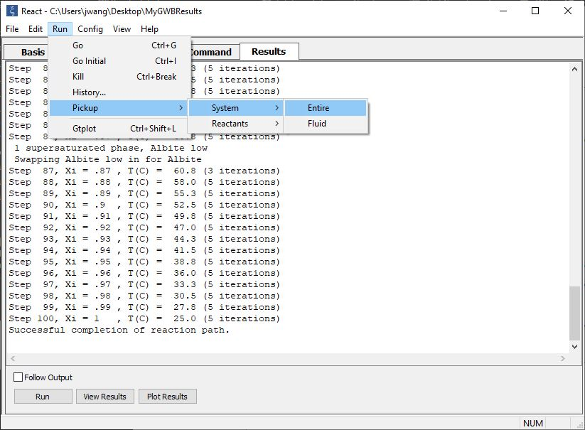
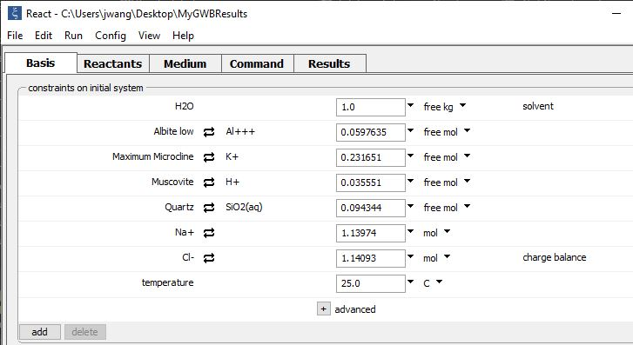
Run → Pickup →
System → Entire puts your entire system in the Basis pane
Bulk composition of fluid and minerals together

Slide 5
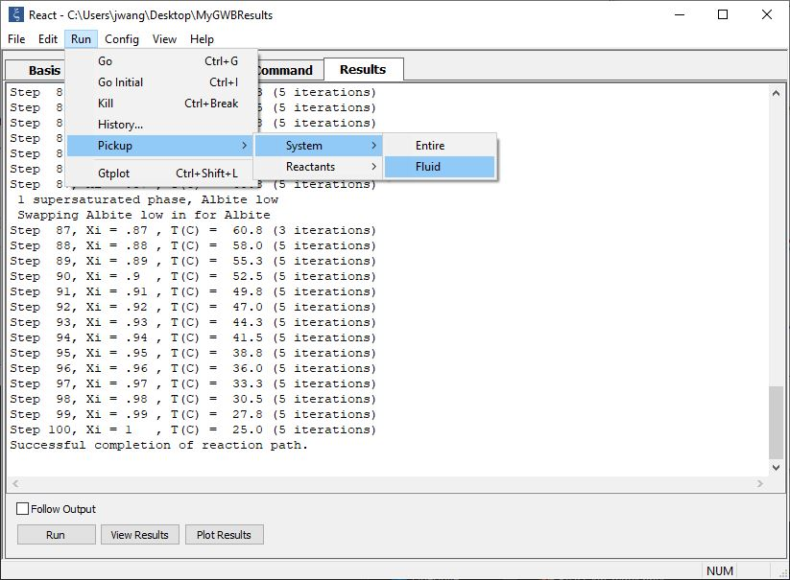
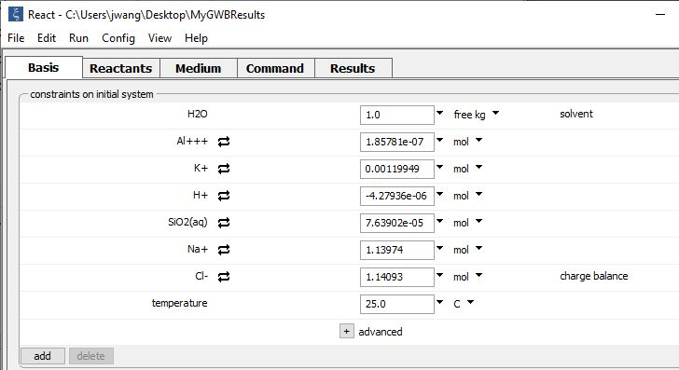
Run → Pickup → System → Fluid takes only the fluid fraction to put in the Basis pane
Fluid fraction only

Slide 6
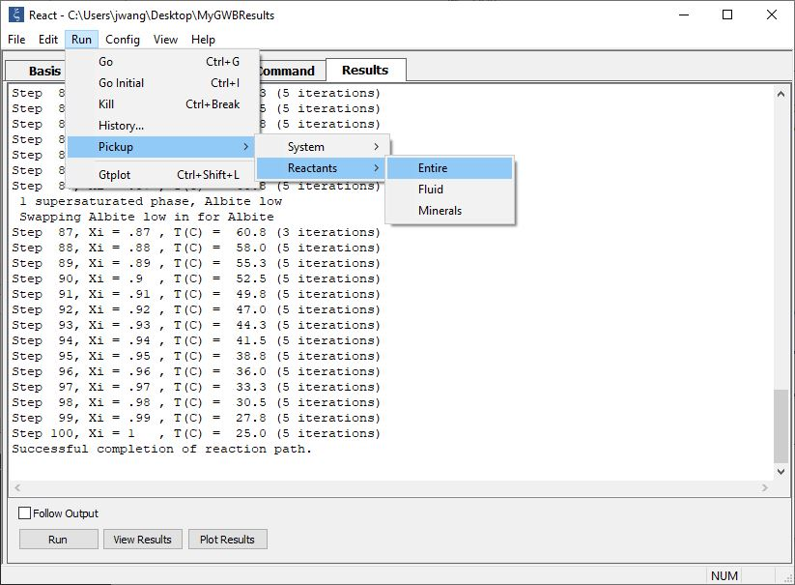
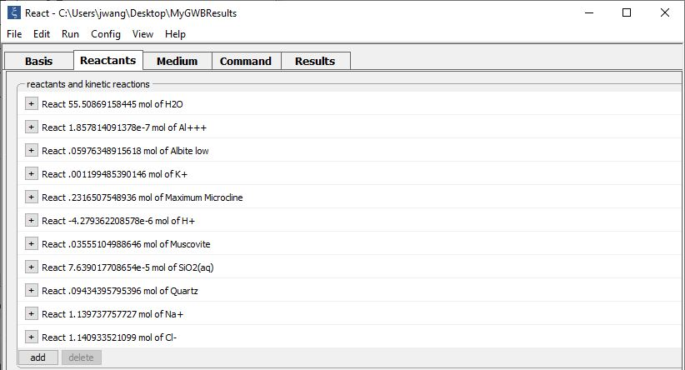
Run → Pickup → Reactants → Entire puts your entire system in the Reactants pane
Bulk composition of fluid and minerals together

Slide 7
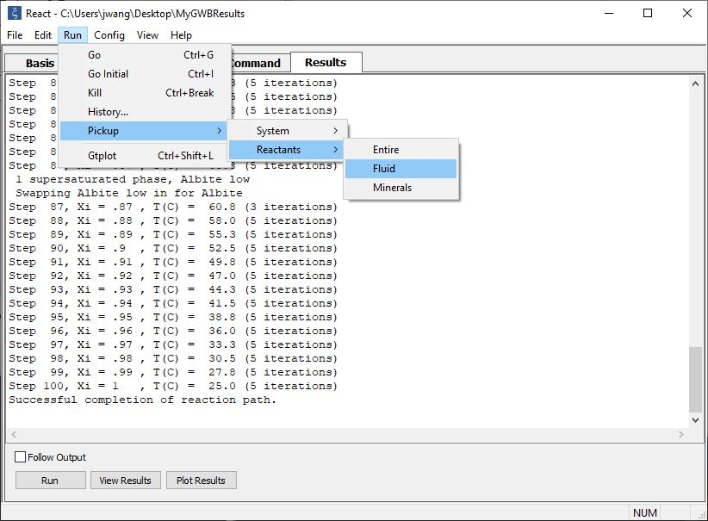
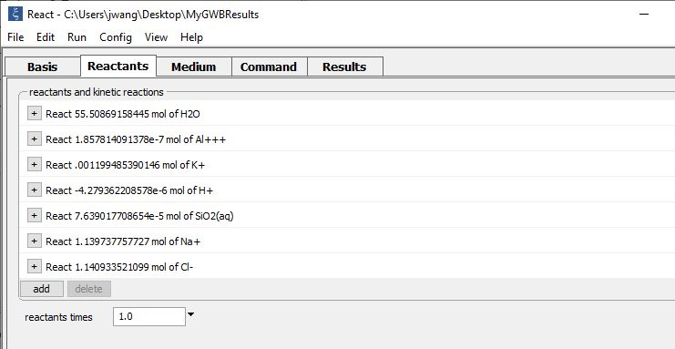
Run → Pickup → Reactants → Fluid takes only the fluid fraction to put in the Reactants pane
Fluid fraction only

Slide 8
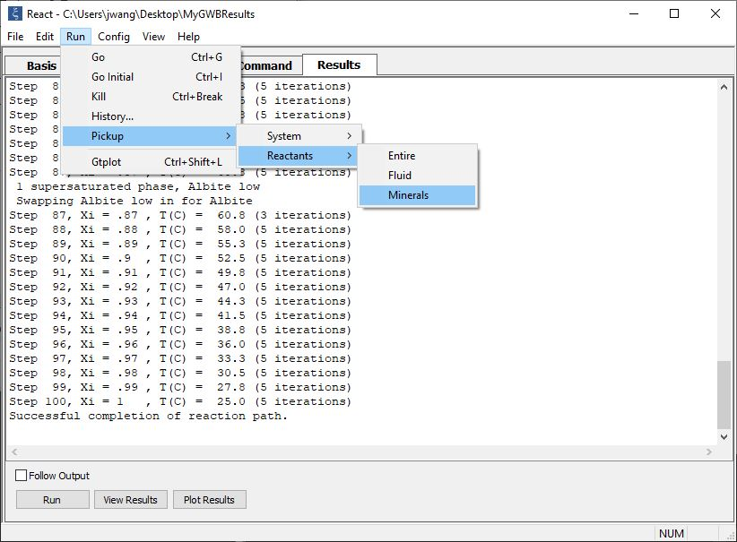
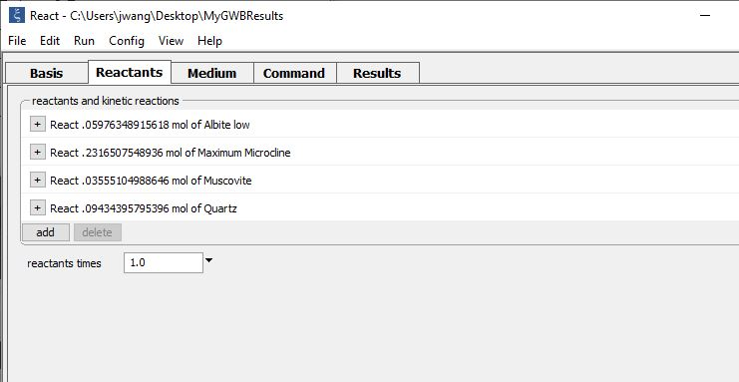
Run → Pickup → Reactants → Minerals puts only the mineral fraction in the Reactants pane
Mineral fraction only

