Slide 1
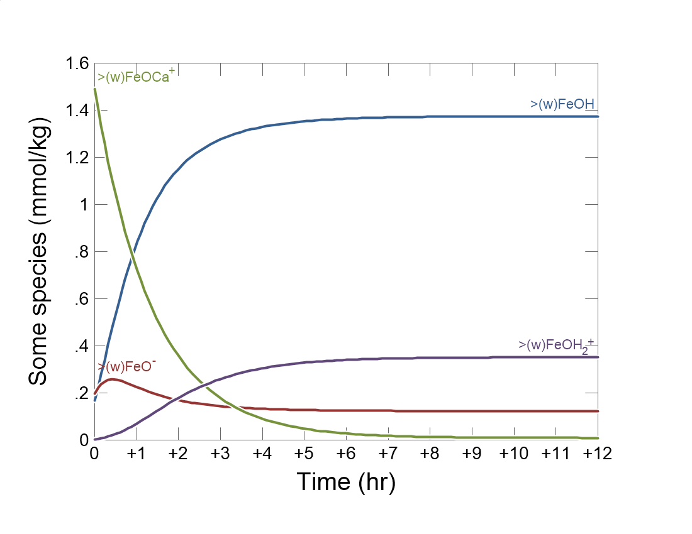

Slide 2
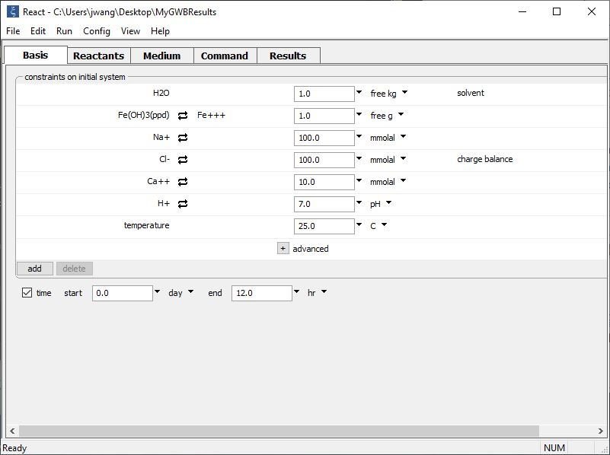
Set the initial fluid composition and mass of sorbing minerals on the Basis pane.
Fe(OH)₃(ppd) sorbs ions. The number of surface sites is proportional to its mass
Set the simulation’s duration

Slide 3
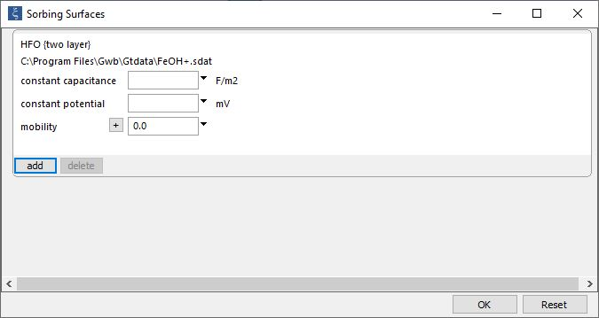
File → Open →
Sorbing Surfaces…
Surface complexation dataset for hydrous ferric oxide.

Slide 4
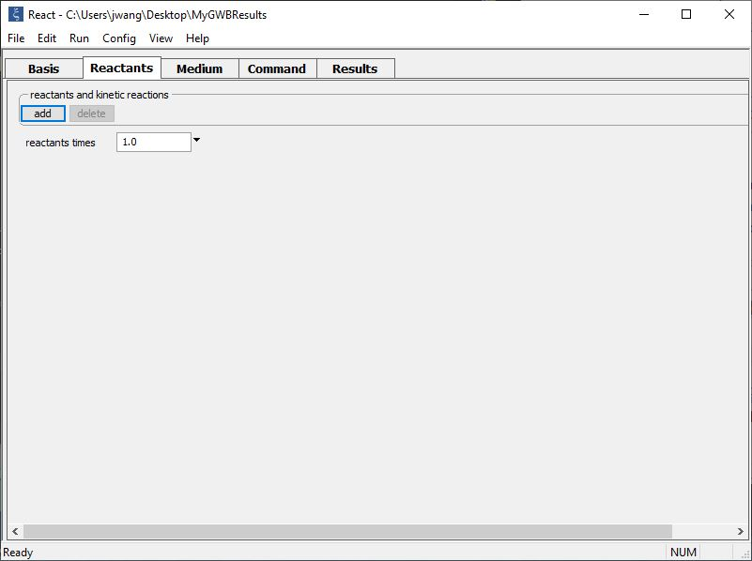
Set up a pH buffer and kinetic rate law on the Reactants pane.
add → Fixed → pH
add → Kinetic →
Sorbed species… >(w)FeOCa+

Slide 5
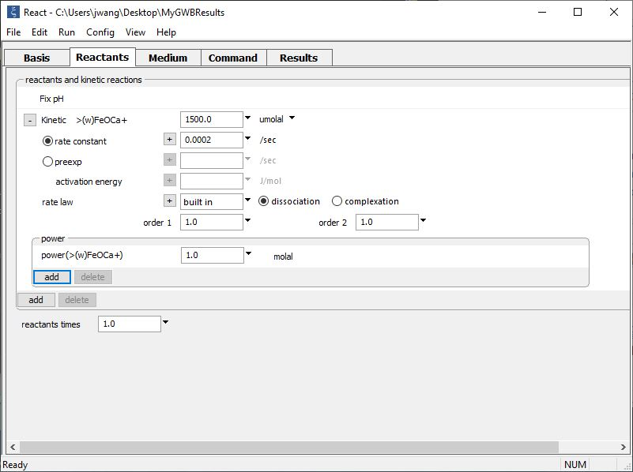
pH buffered to initial value
Supply kinetic parameters
Initial concentration of surface complex
Rate constant
Desorption rate is proportional to the concentration of the >(w)FeOCa⁺

Slide 6
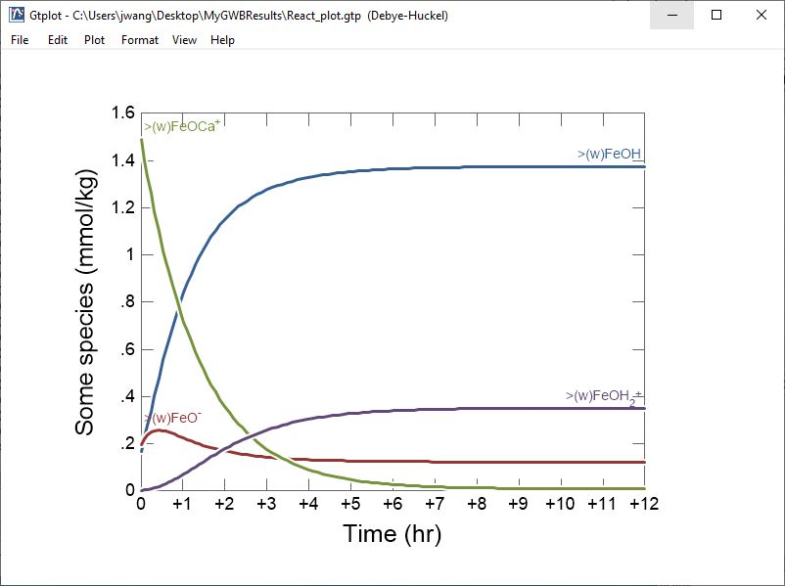
Desorption of Ca⁺⁺ from a ferric oxyhydroxide surface

