Slide 1
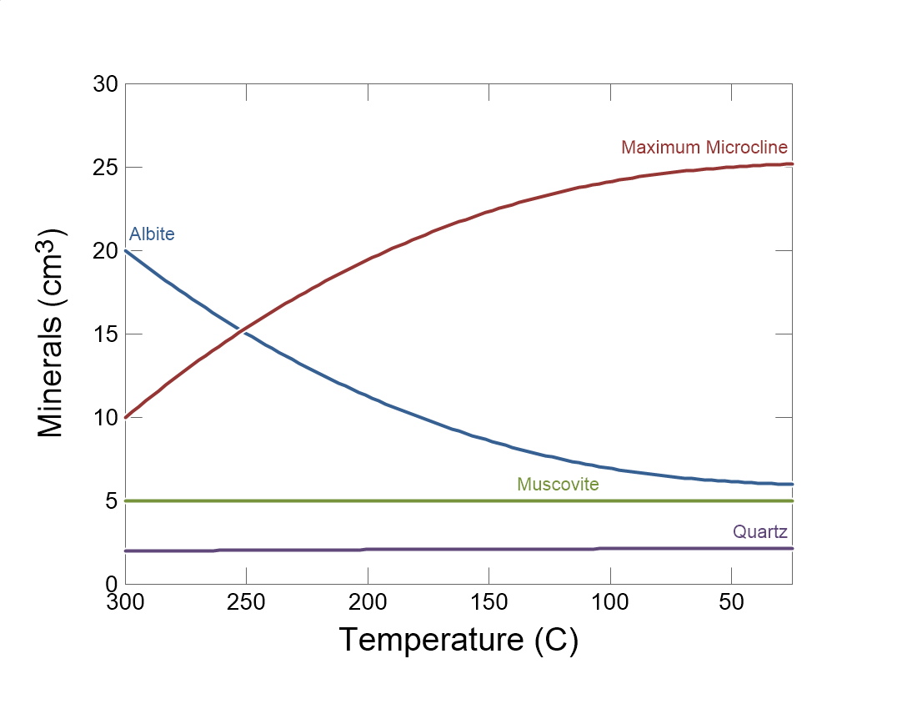

Slide 2
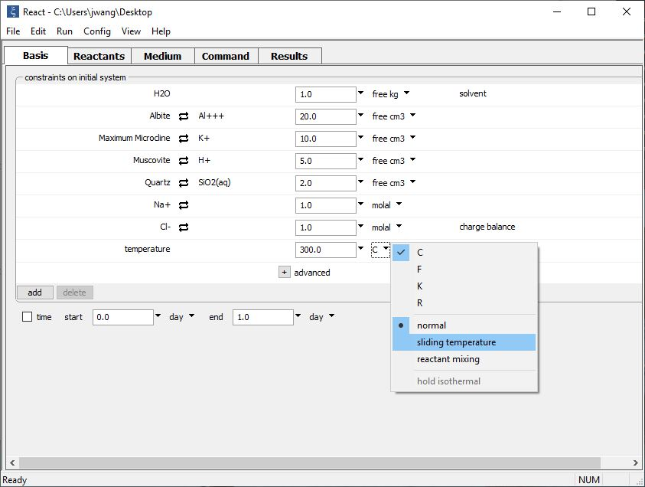
Set the initial fluid temperature on the Basis pane, and how it should vary.
Na-Cl fluid in equilibrium with four minerals at 300°C
Click the pulldown next to the temperature unit, then choose “sliding temperature”
Initial temperature
Alternatively, you can set up a polythermal mixing path by selecting “reactant mixing”

Slide 3
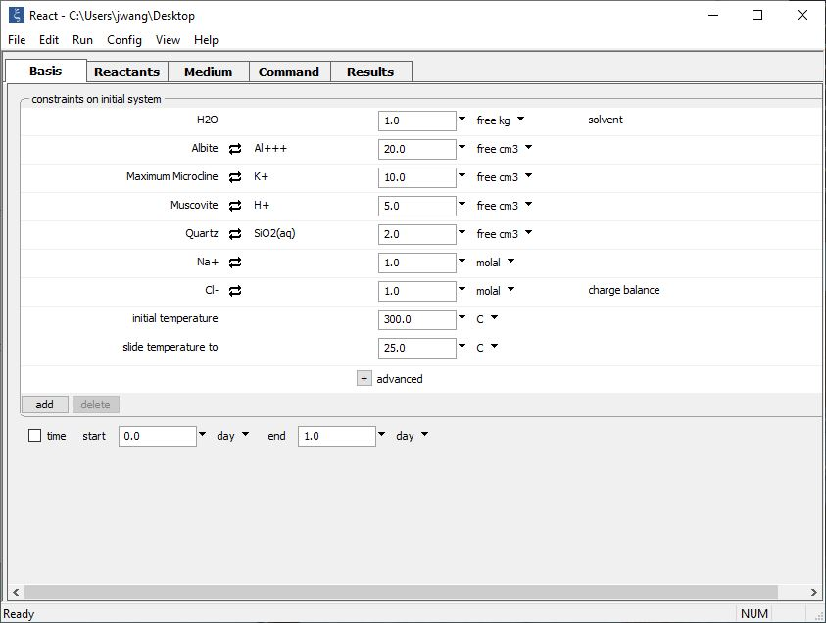
Set a final temperature in the “slide temperature to” field that appears

Slide 4
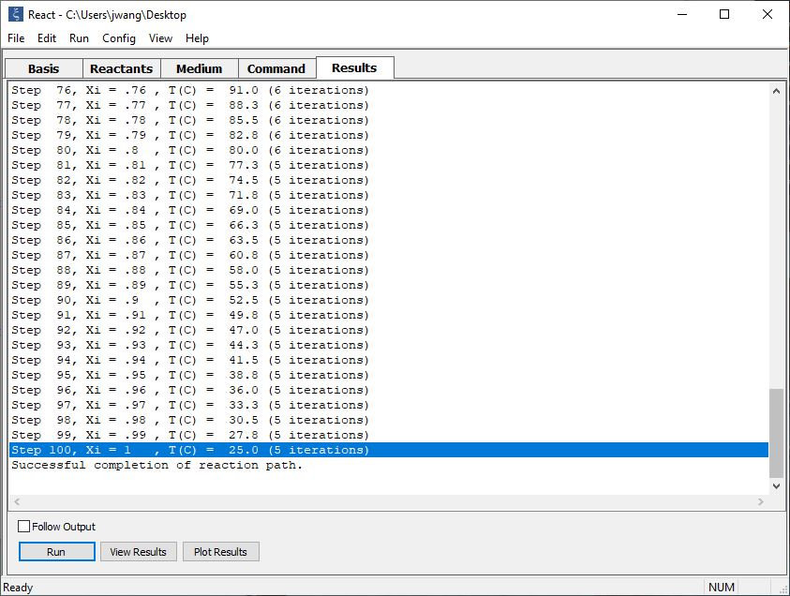
On the Results pane, click Run to execute the calculation.
The system is gradually cooled from 300°C to 25°C

Slide 5
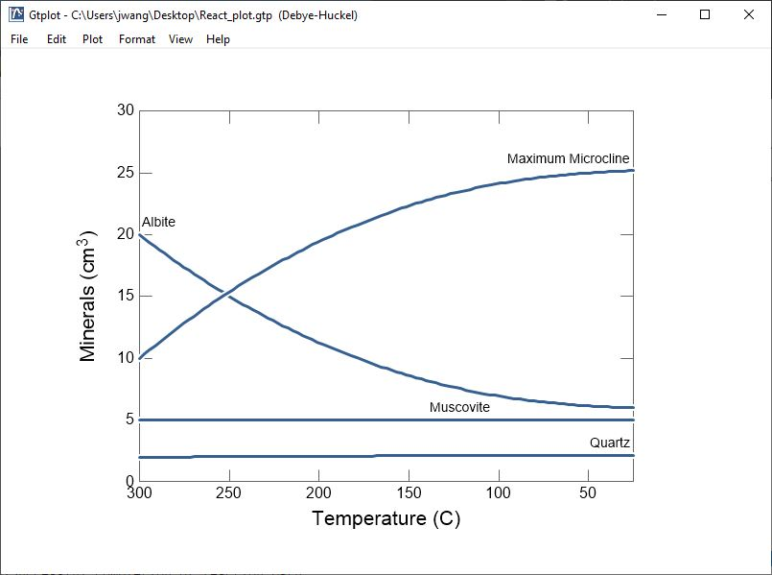
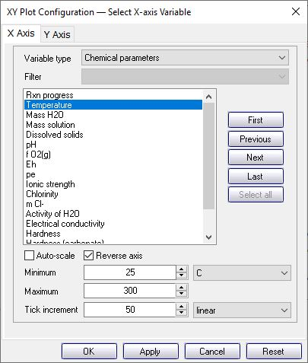
Albite is more stable than Microcline in this system at high temperatures, but as the system cools Albite dissolves and Microcline precipitates.
Hint: You can reverse the axis to better describe the cooling path.

