Slide 1
Equilibrium equations

Slide 2
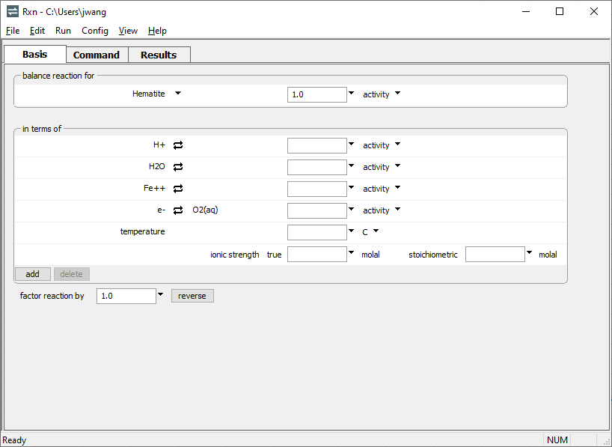
You can use Rxn to calculate equilibrium lines, such as those appearing on activity diagrams.
Choose species to appear on left side of reaction.
Perform basis swaps as necessary to rebalance reaction.

Slide 3
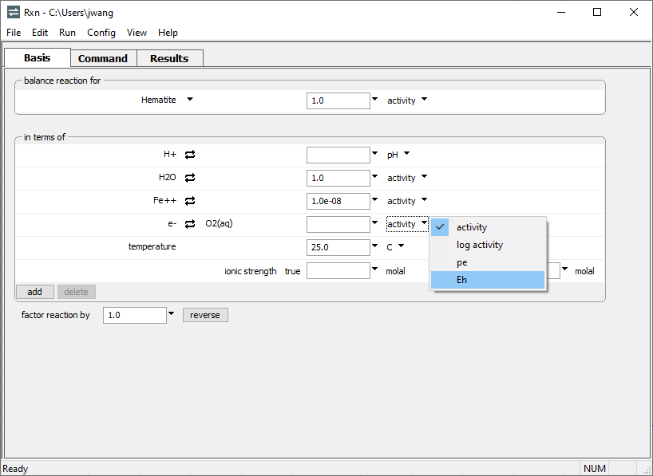
Constrain the activity of species in the reaction.
Set temperature
Choose Eh units
Run → Go
calculates the equation

Slide 4
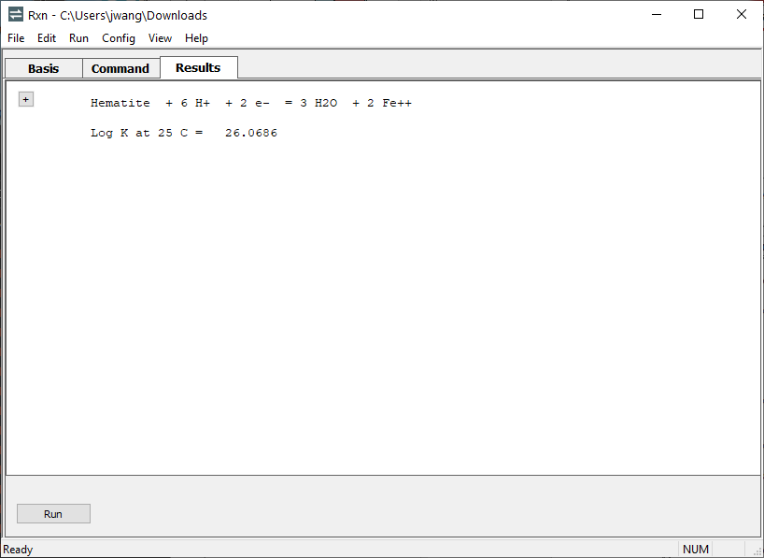
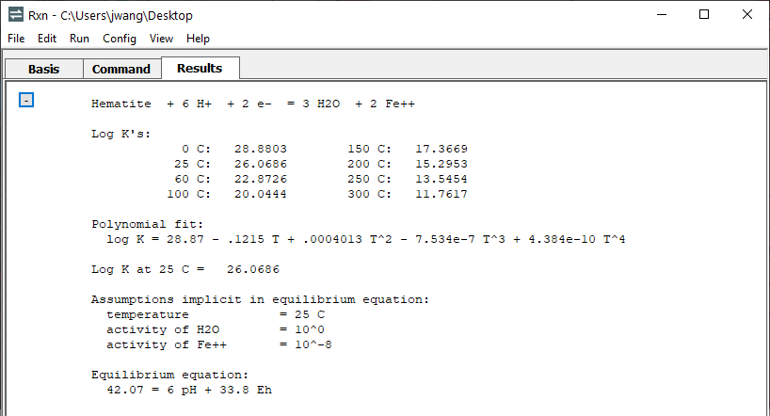
Click to expand output
User assumptions simplify the equation
Equation for equilibrium line is written in terms of Eh and pH

