Slide 1
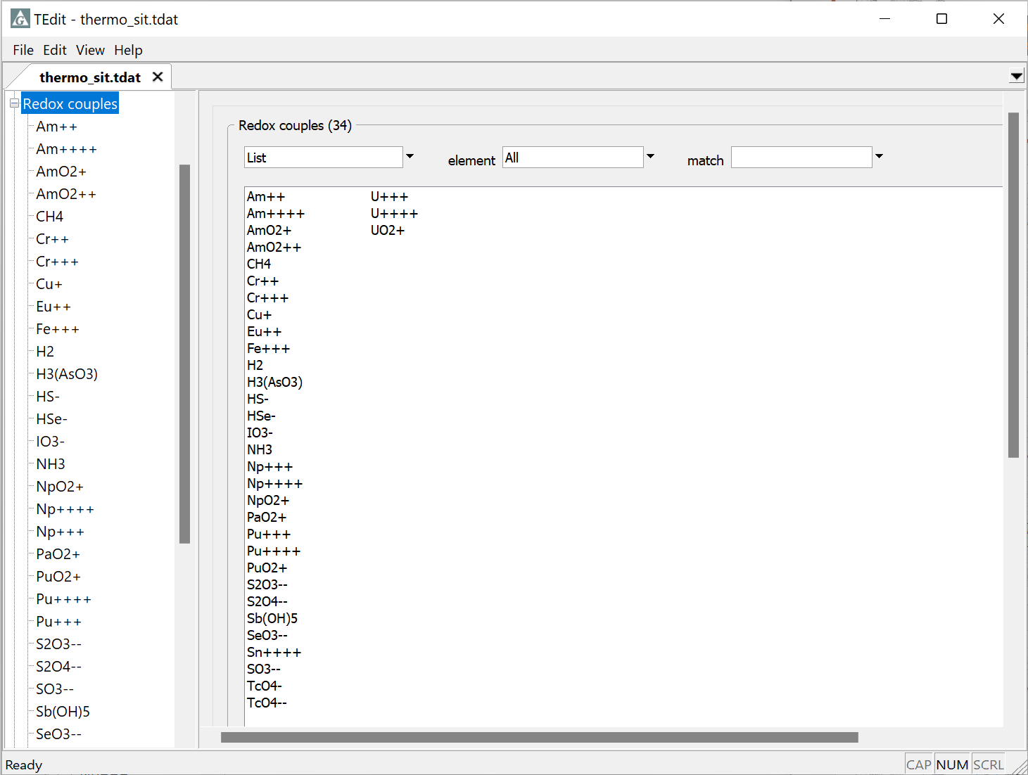
Coupling and decoupling redox reactions

Slide 2
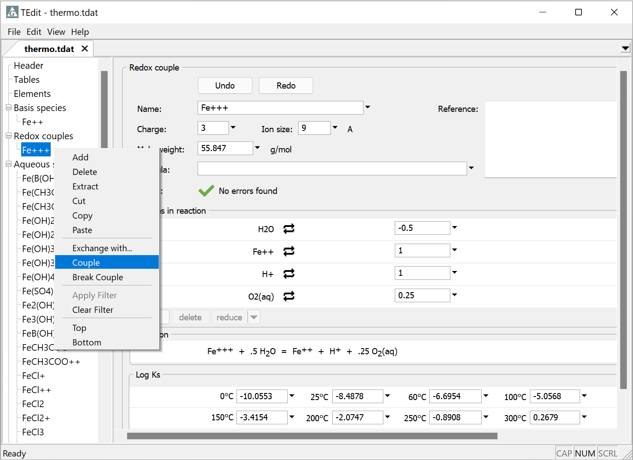
You can permanently enable a redox coupling reaction in the thermodynamic dataset using the Couple feature
Right-click on the redox species
Select Couple

Slide 3
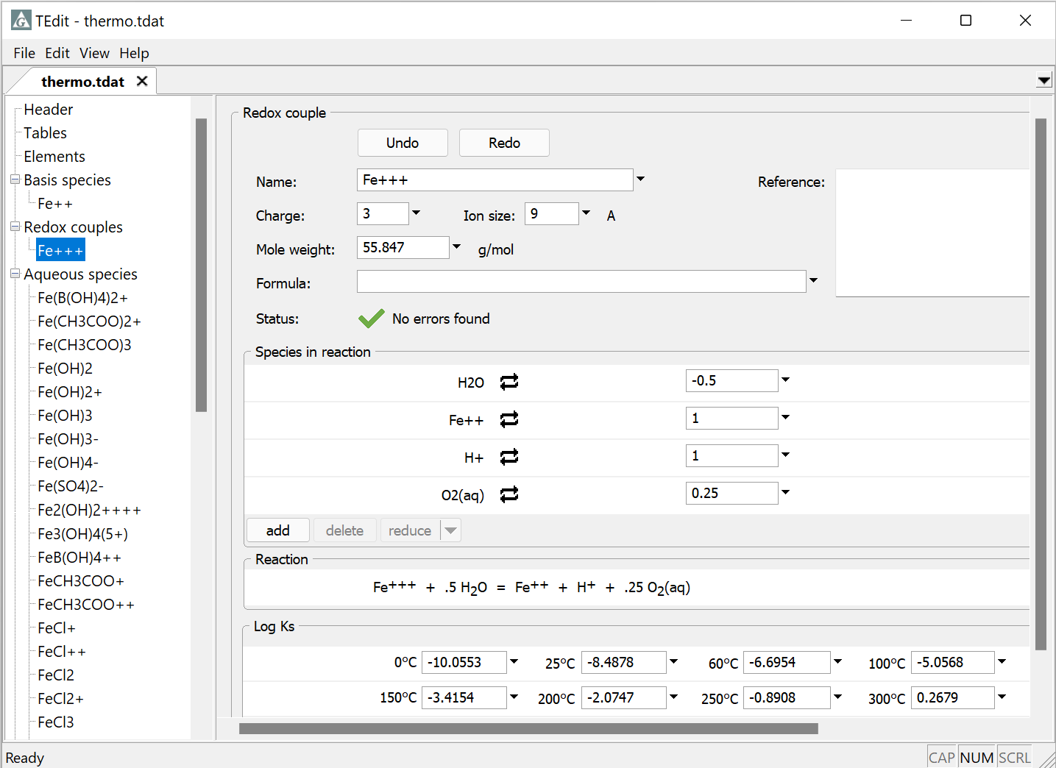
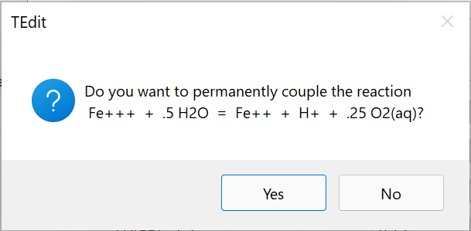
Click Yes to couple Fe³⁺ reaction

Slide 4
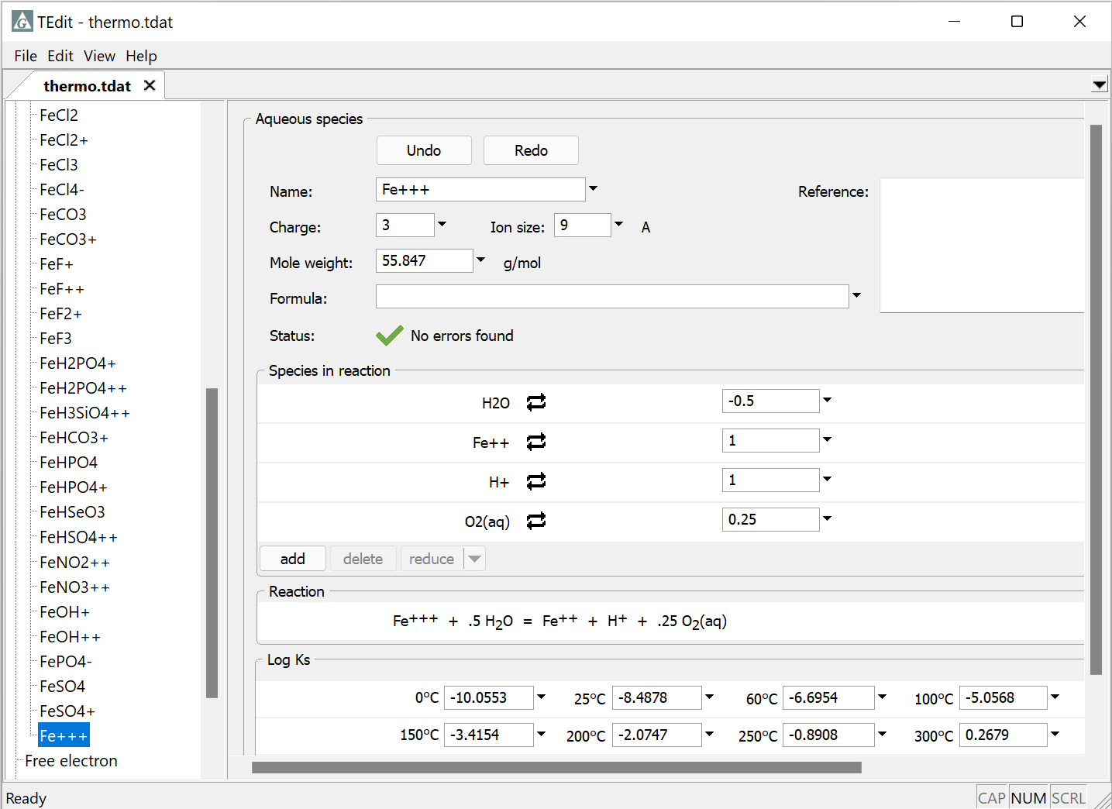
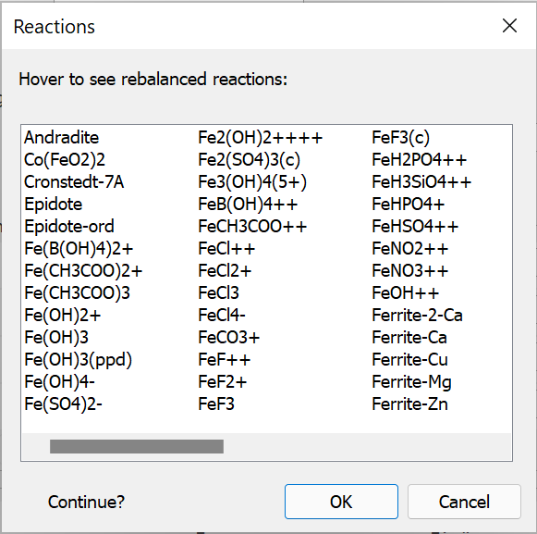
Coupled reaction is moved to aqueous species section
Select OK to rebalance reactions
Select cancel to preserve current reactions

Slide 5
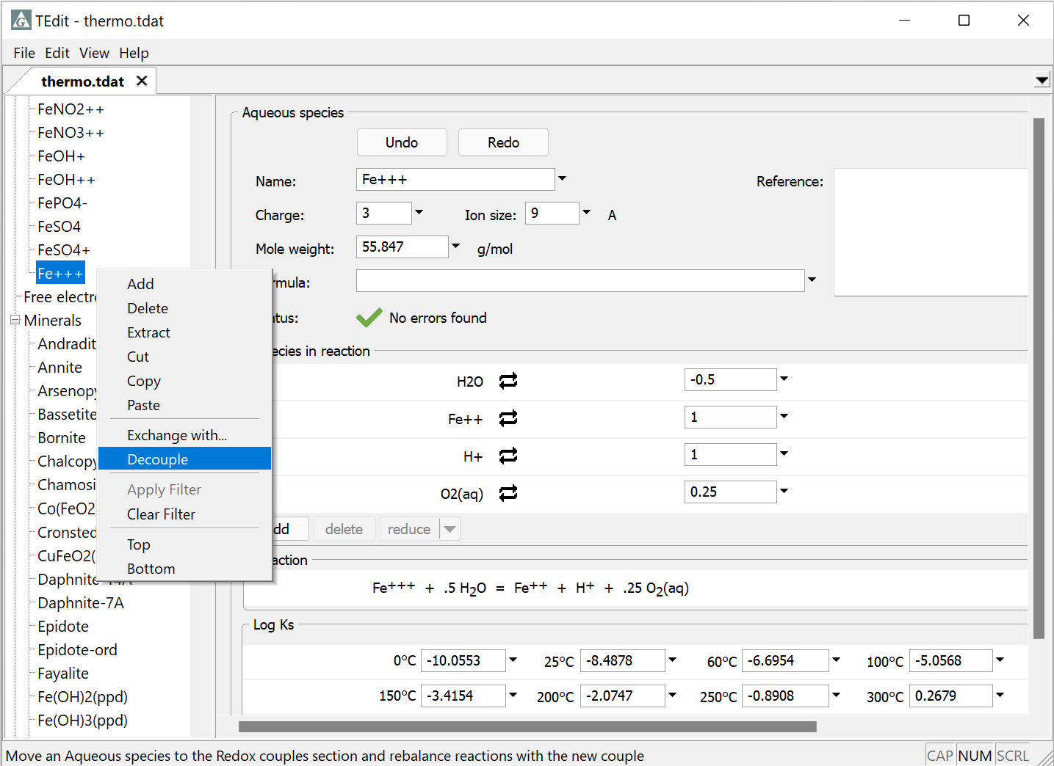
To use an aqueous species reaction as a redox coupling reaction, use the Decouple feature
Right-click on the redox species
Select Decouple

Slide 6
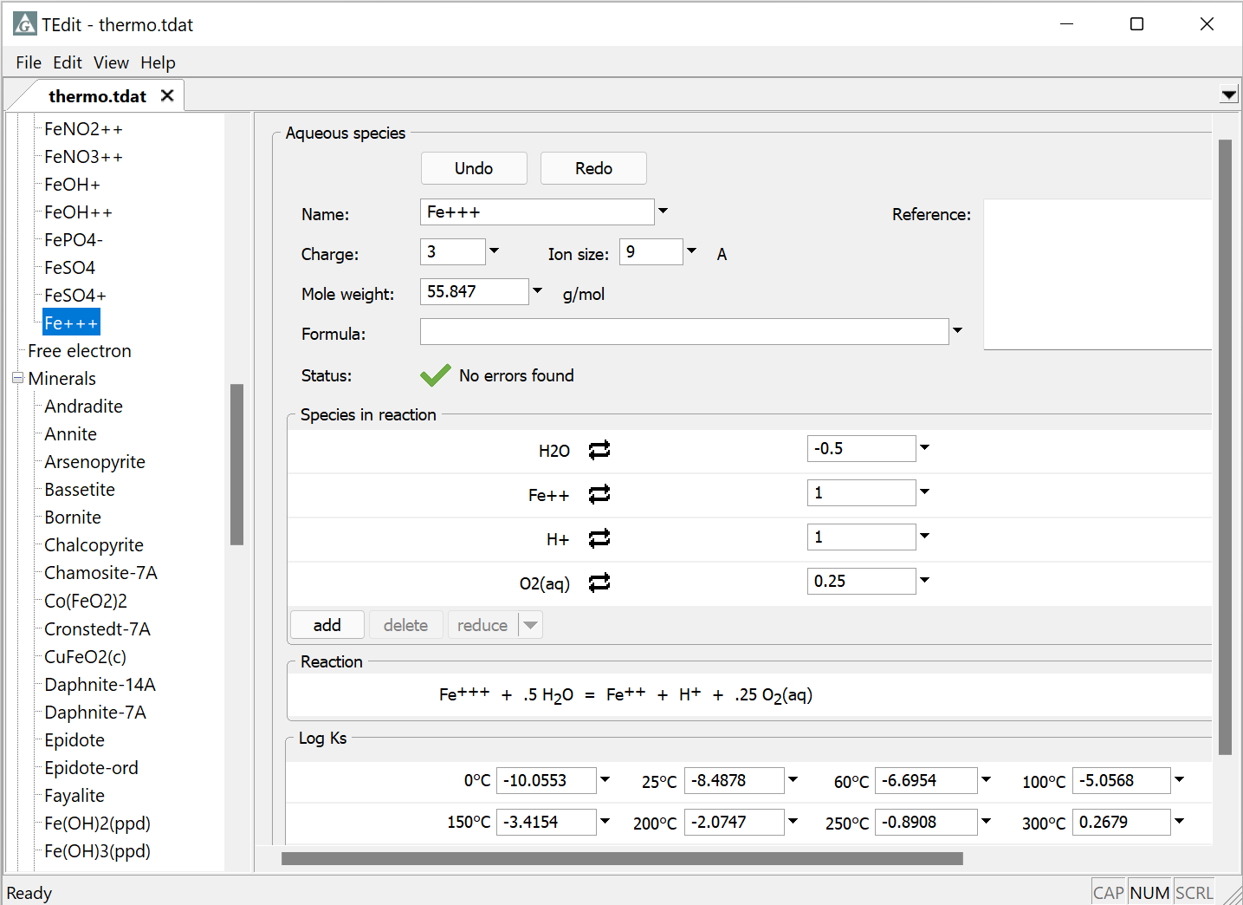
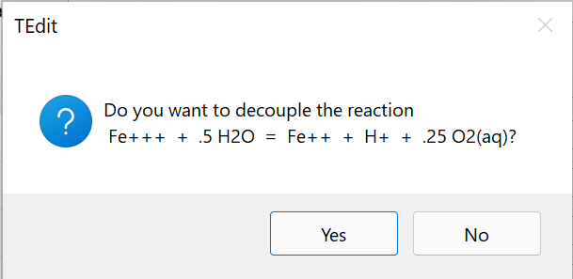
Select Yes to decouple reaction

Slide 7
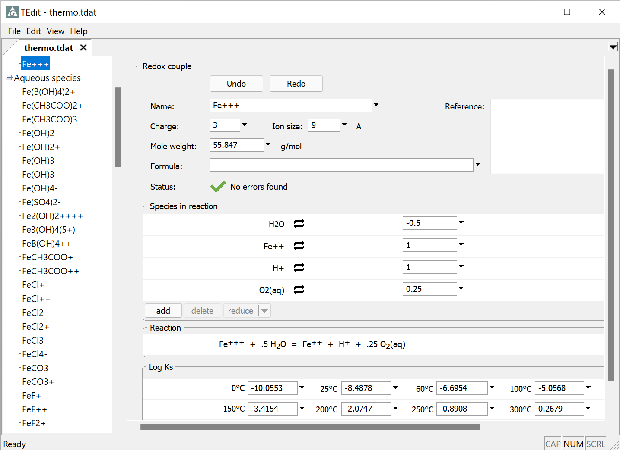
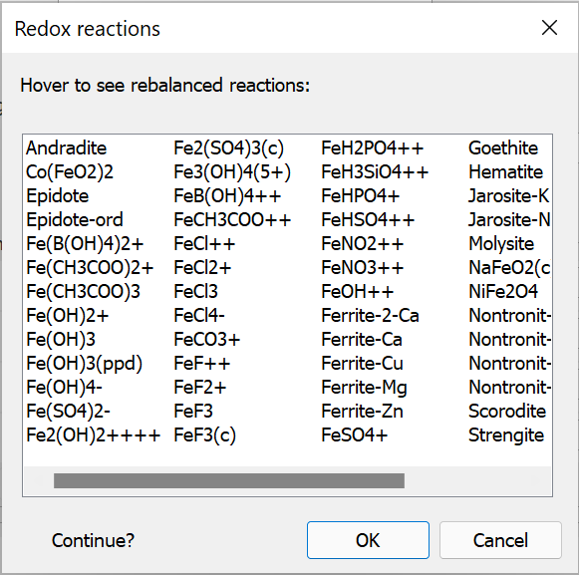
Aqueous reaction is moved to Redox Couples section
Select OK to rebalance reactions
Select cancel to preserve current reactions

