Slide 1
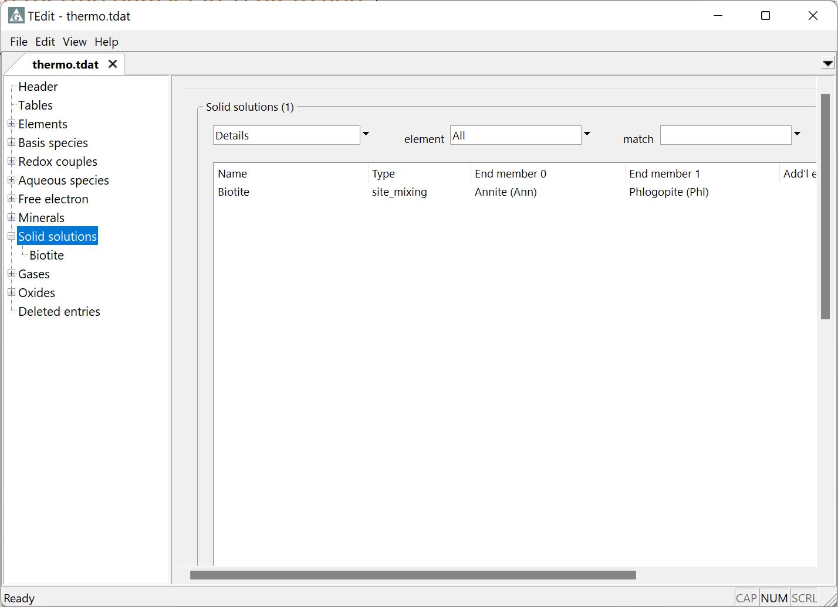
Add solid solutions to thermos datasets

Slide 2
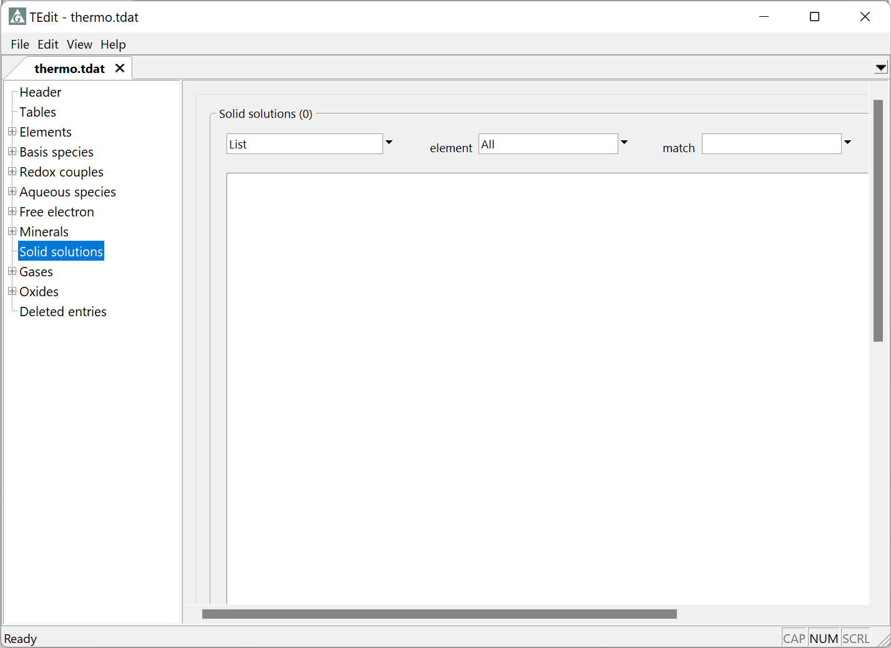
Open thermo dataset in TEdit to add and edit solid solution
Add new Solid solution
Right-click → Add

Slide 3
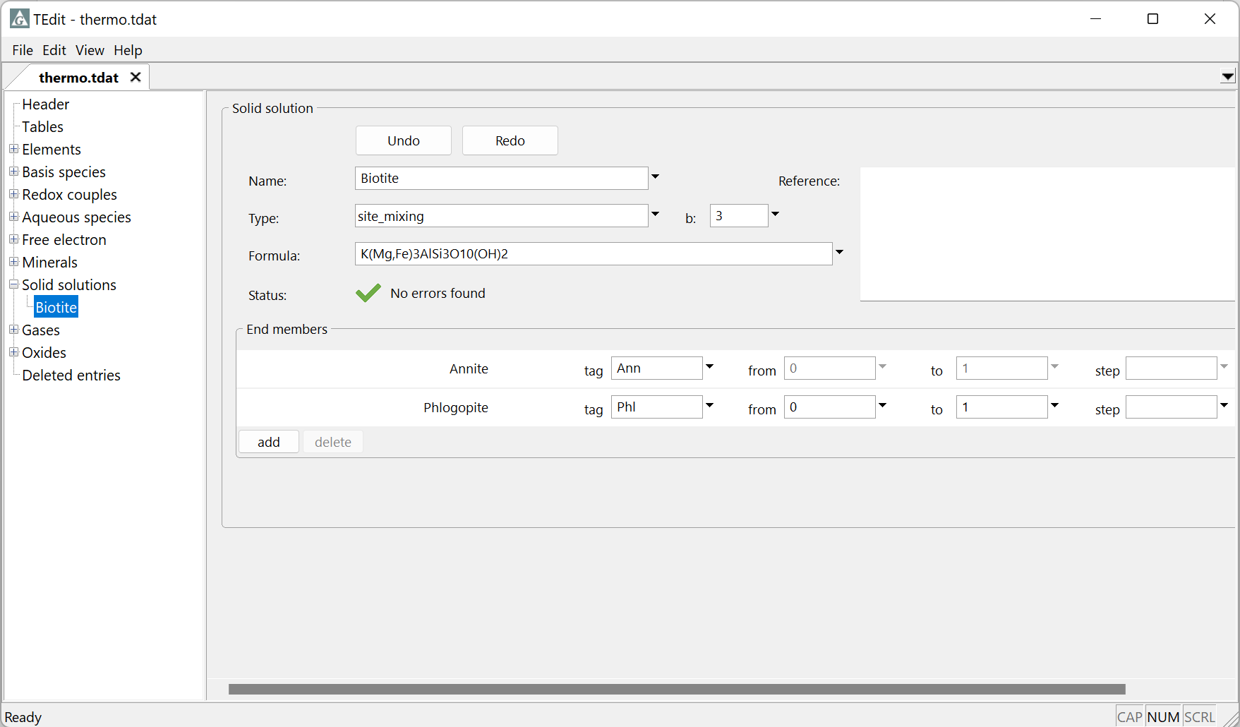
Supply solid solution name
Select activity model type
Site number for site_mixing solutions
Add the appropriate end members
Supply a tag for each end member mineral

Slide 4
Save your changes by going to File → Save As… or File → Save

