Slide 1
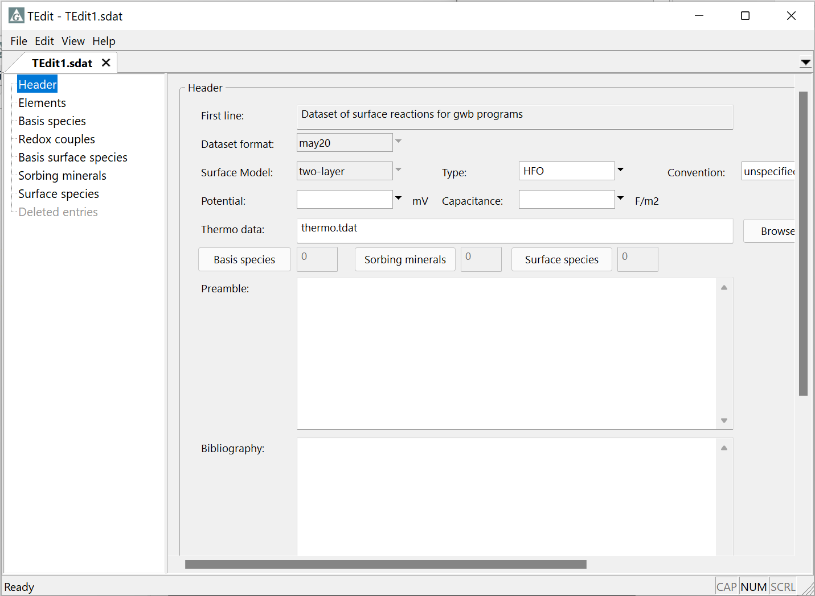
Two-layer datasets

Slide 2
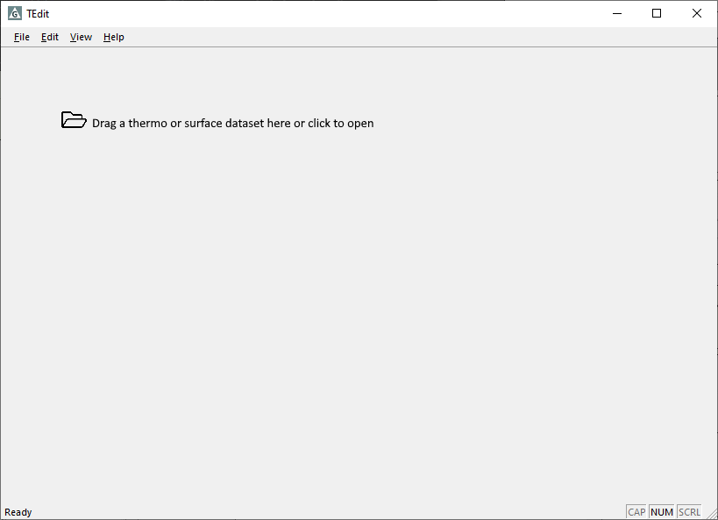
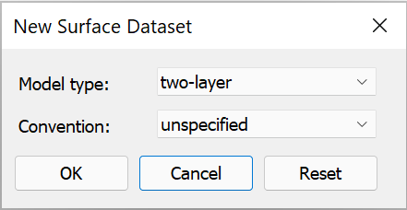
File → New → Sorbing Surfaces…
Select two-layer
Choose a convention for polydentate complexation, if desired

Slide 3
Enter a unique identifier for the sorbing surface
You can optionally set a constant potential or capacitance value
Aqueous species are drawn from this thermo dataset to create surface reactions

Slide 4
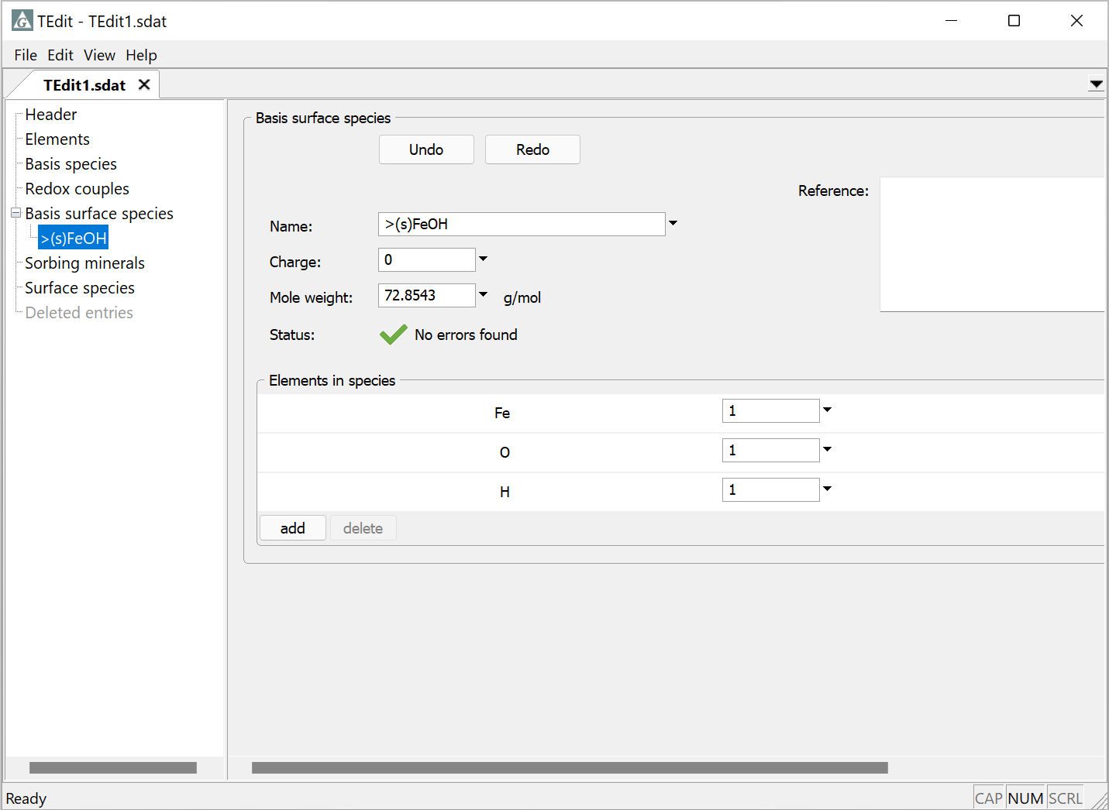
Two-layer datasets must have one or more sorbing sites – the Basis surface species
Uncomplexed strong site
Right-click → Add
Compose new Basis surface species >(s)FeOH from elements: add Fe, O, H

Slide 5
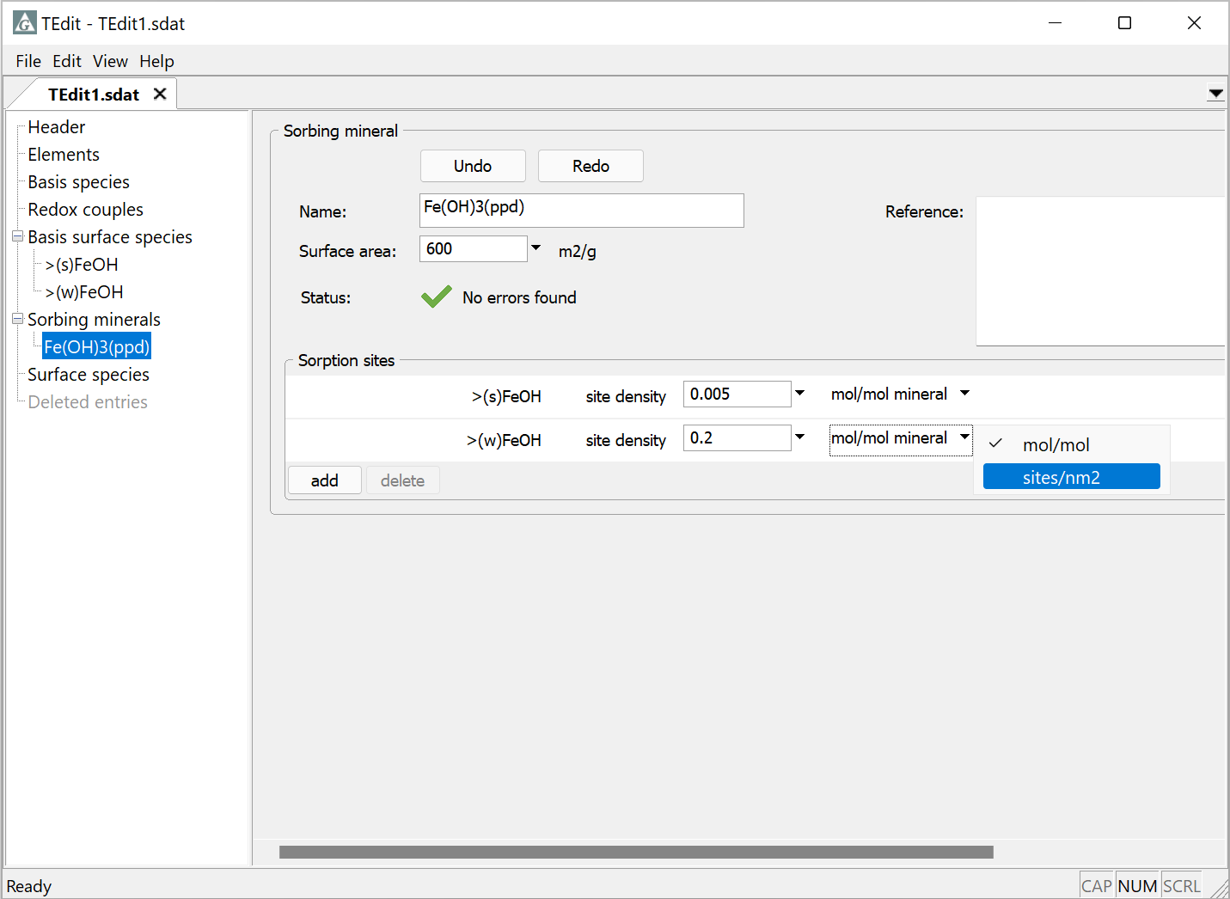
Associate surface sites with minerals from a thermo dataset and set their site density
Fe(OH)₃(ppd) selected from list of minerals in thermo dataset
A_{sp}
Right-click → Add
Each sorbing mineral can contain one or more of the sorbing sites (the surface basis species)
Enter site density in moles/mole mineral or sites/nm²

Slide 6
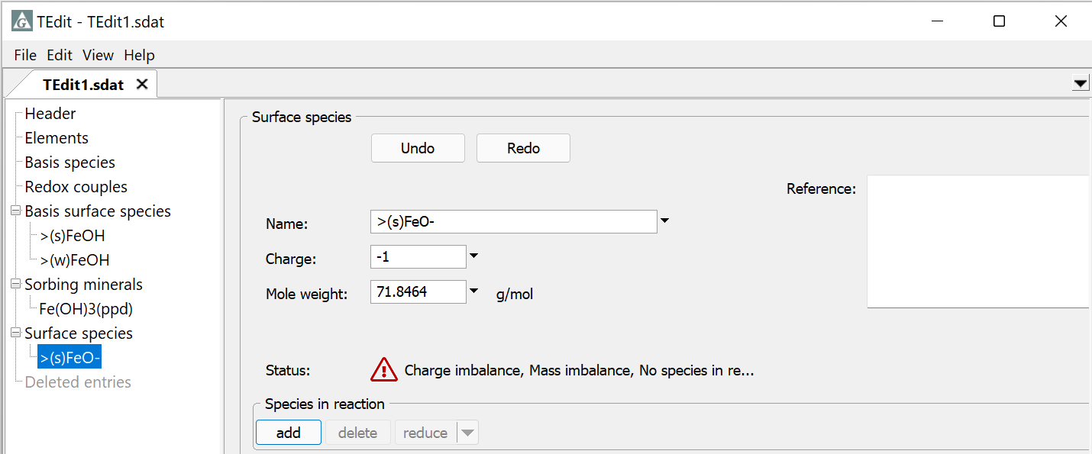
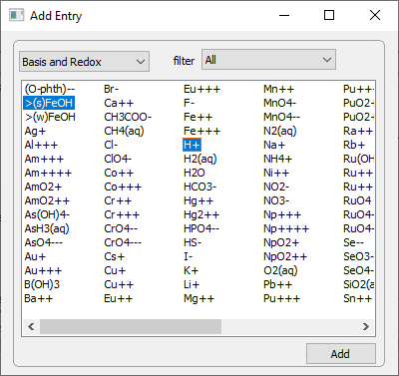
Add surface protonation, deprotonation, and complexation reactions
Deprotonated strong sorbing site
Right-click → Add
Click add to bring up the Add Entry dialog

Slide 7
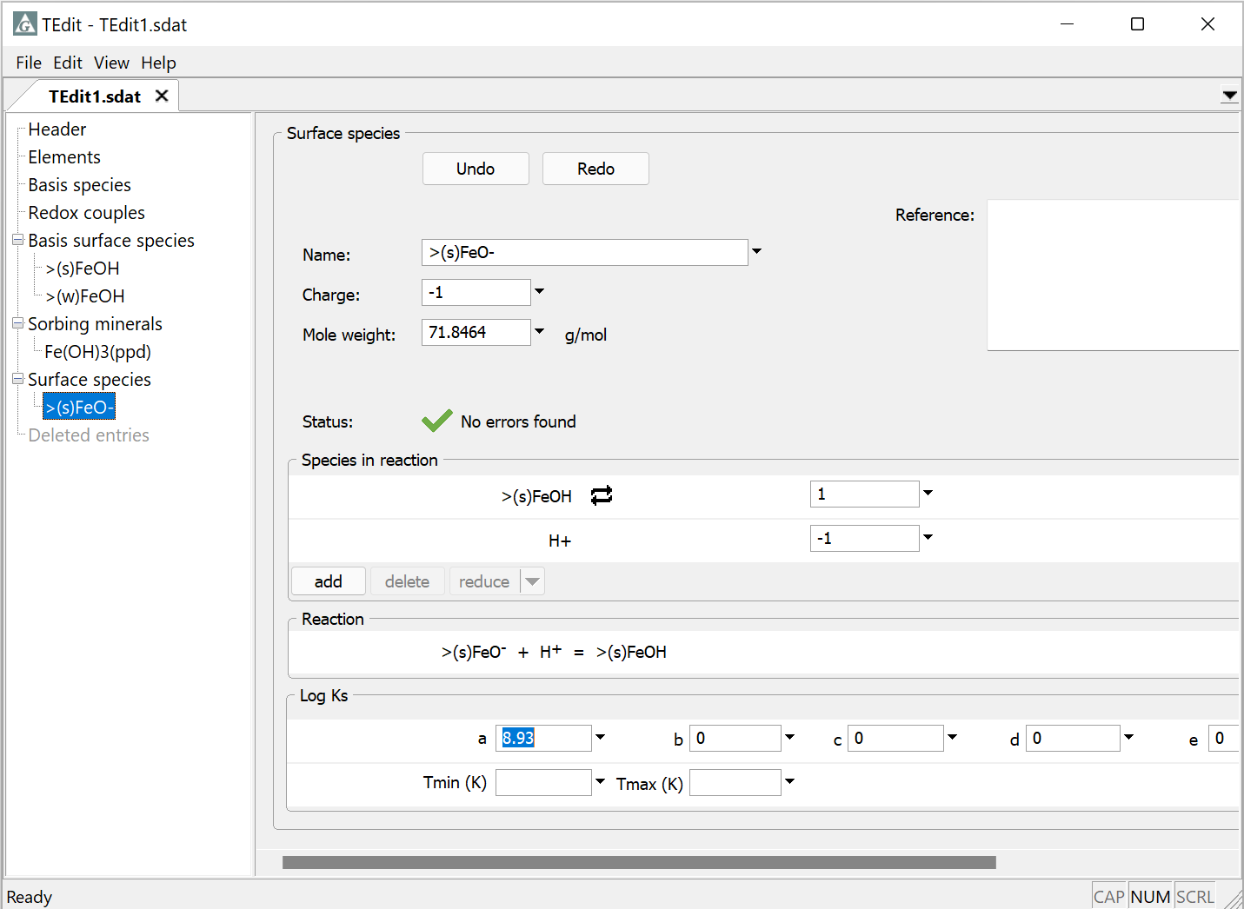
Supply reaction coefficients
Surface complex is composed of aqueous species and an uncomplexed surface site
In GWB 2021 and newer releases, set a polynomial temperature expansion for the equilibrium constant; “a” is the log K value at 25°C.

