Slide 1
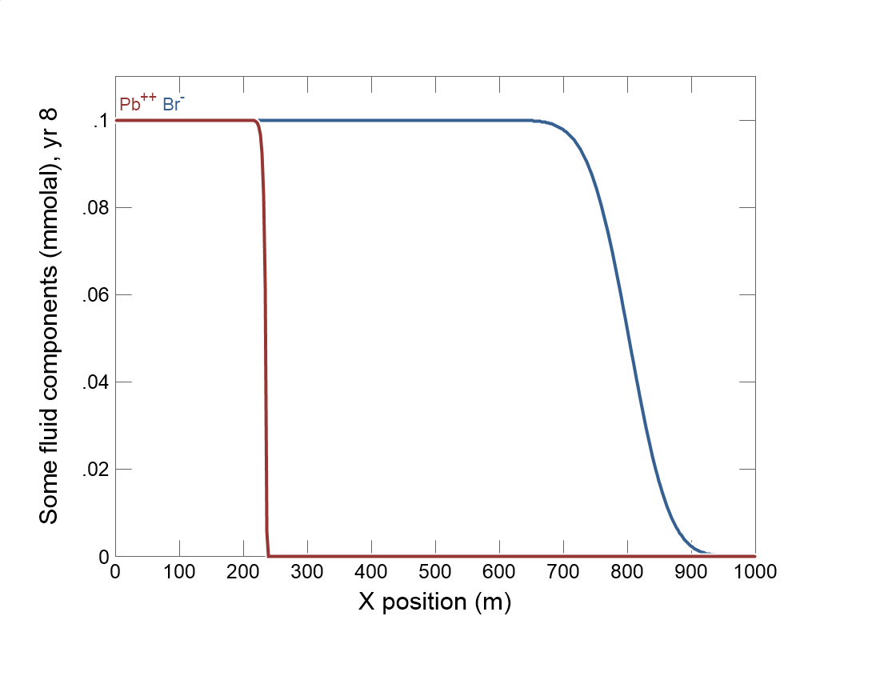

Slide 2
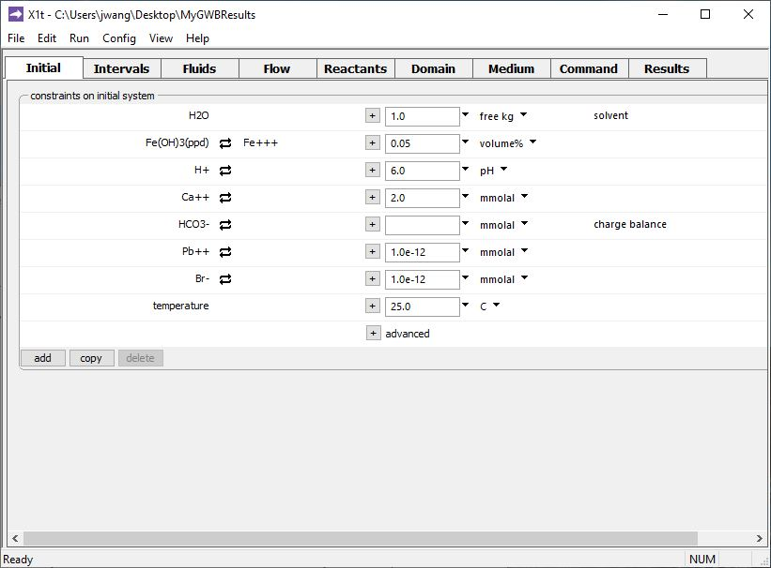
Specify domain’s starting fluid composition on the Initial pane
Pb⁺⁺ will complex with ferric hydroxide mineral in the aquifer.
Clean water

Slide 3
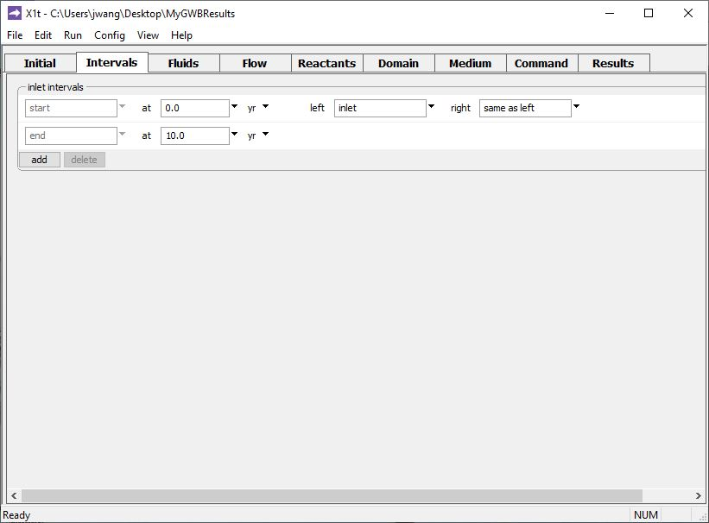
Define the reaction intervals. Specify what fluids flow into the domain, and when.
A single inlet fluid flows into the domain for 10 years.
Click to add a new reaction interval

Slide 4
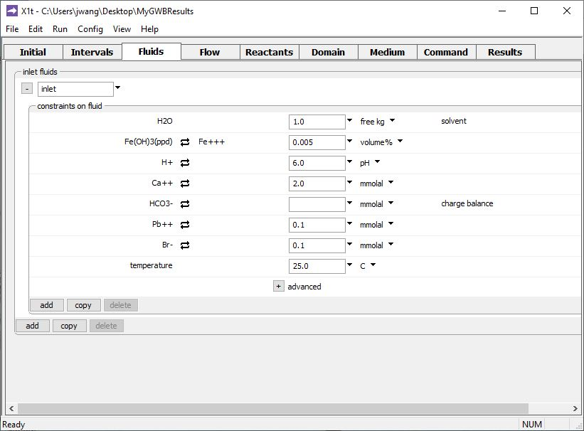
The inlet fluid is defined on the Fluids pane
Inlet fluid carries Pb⁺⁺ and nonreactive Br⁻ into the domain

Slide 5
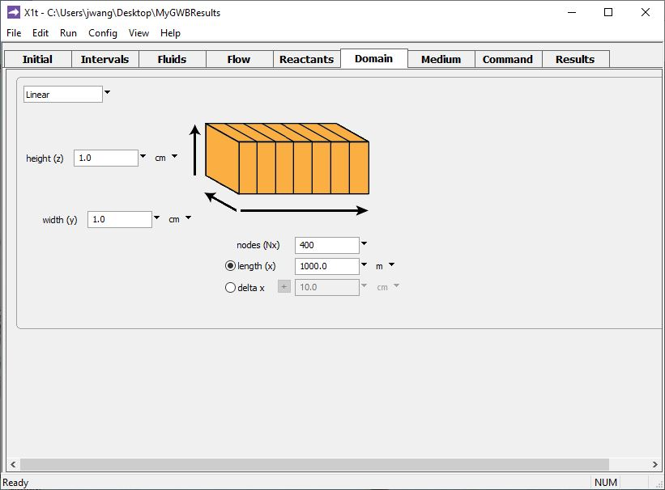
Specify domain size and gridding on the Domain pane.
Domain is 1 km long, divided into 400 nodal blocks

Slide 6
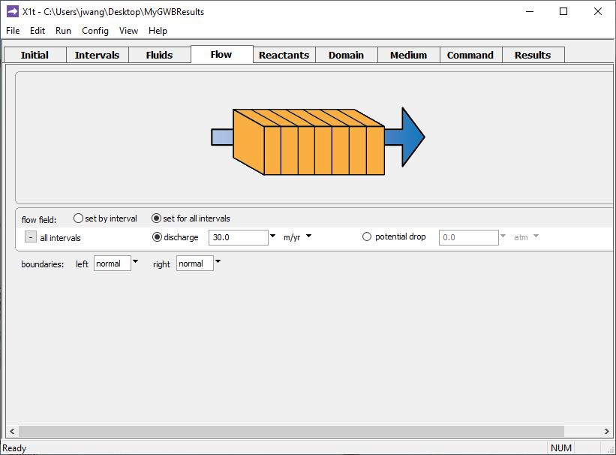
Specify flow rate on the Flow pane.
Set specific discharge or hydraulic head/ potential drop

Slide 7
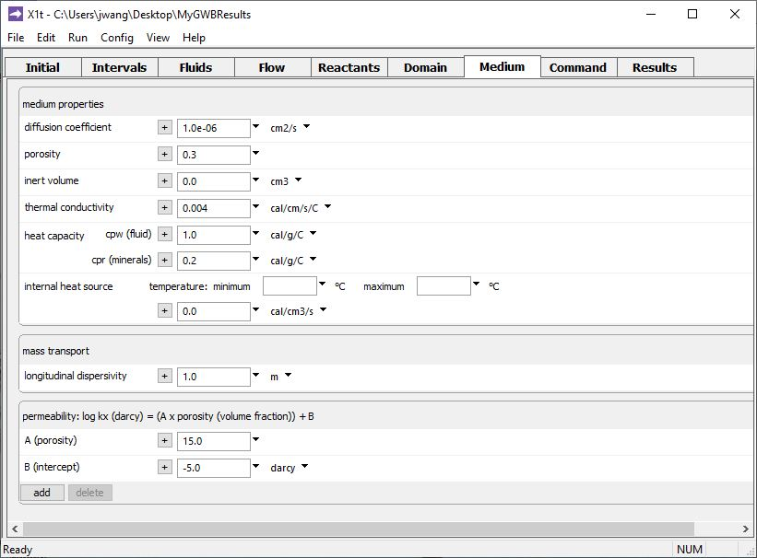
Set various mass transport properties on the Medium pane.

Slide 8
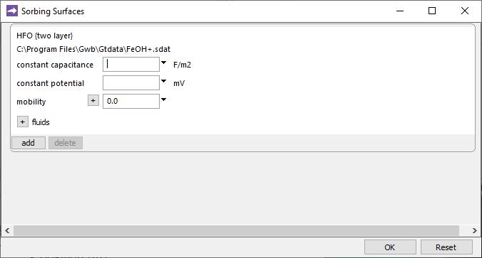
File → Open → Sorbing Surfaces…
Surface complexation dataset for hydrous ferric oxide. Mobility defaults to 0, indicating HFO is not transported.
You can add any number of sorbing surfaces.

Slide 9
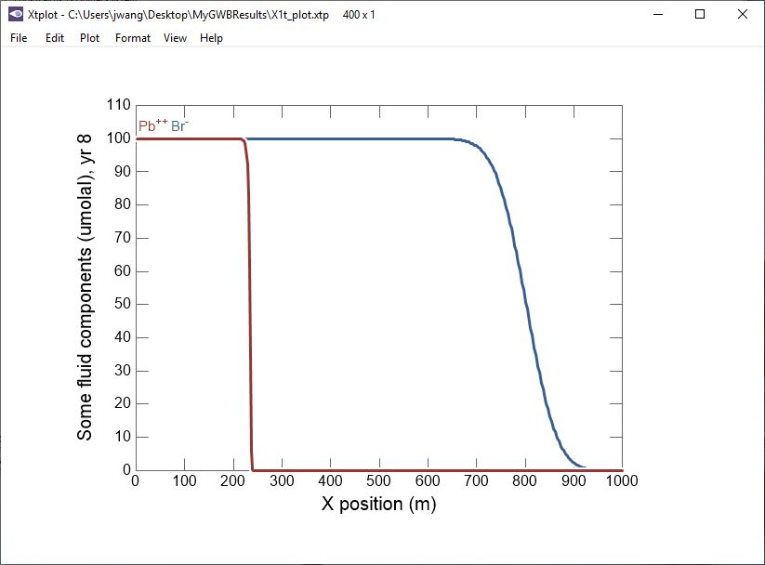
Surface complexation retards Pb⁺⁺ transport relative to nonreactive tracer Br⁻.

