Slide 1
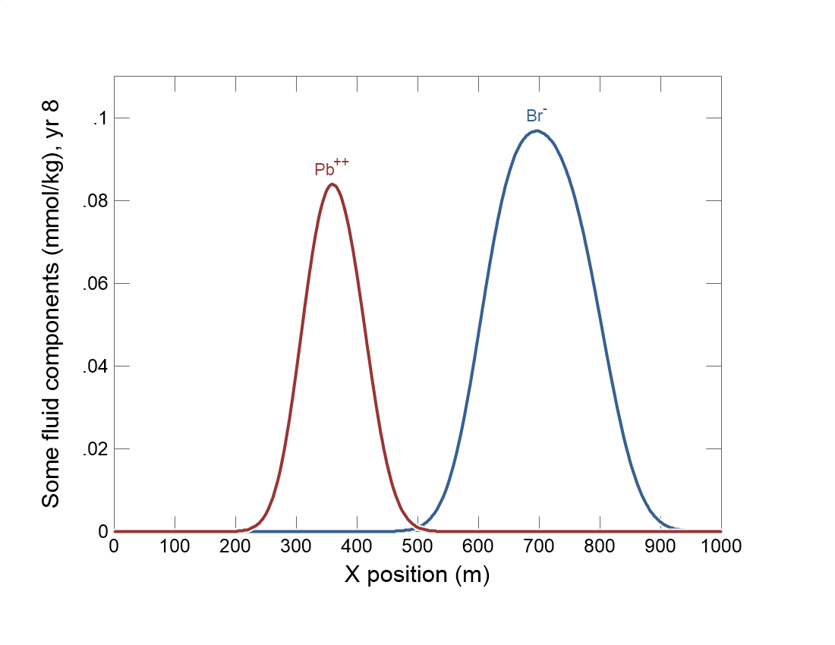

Slide 2
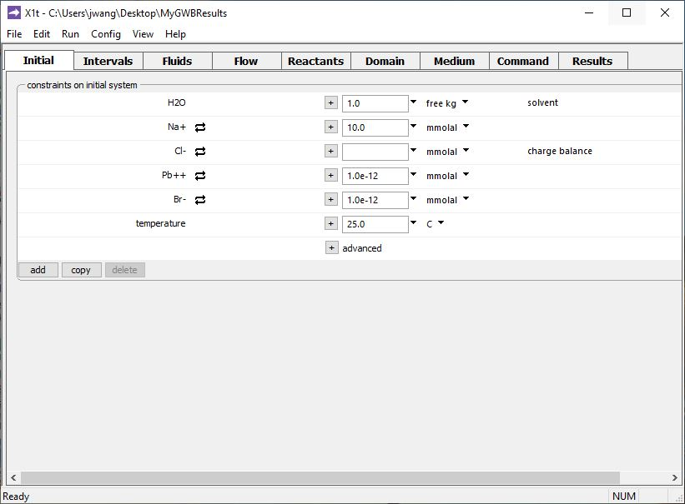
Specify domain’s starting fluid composition on the Initial pane
Clean water

Slide 3
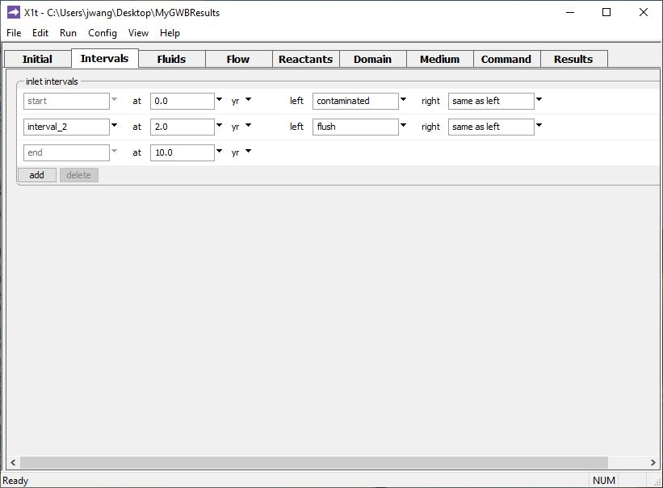
Define the reaction intervals. Specify what fluids flow into the domain, and when.
Inlet fluid “contaminated” enters the domain from t = 0 to 2 years
Inlet fluid “flush” enters the domain from t = 2 to 10 years
Click to add a new reaction interval

Slide 4
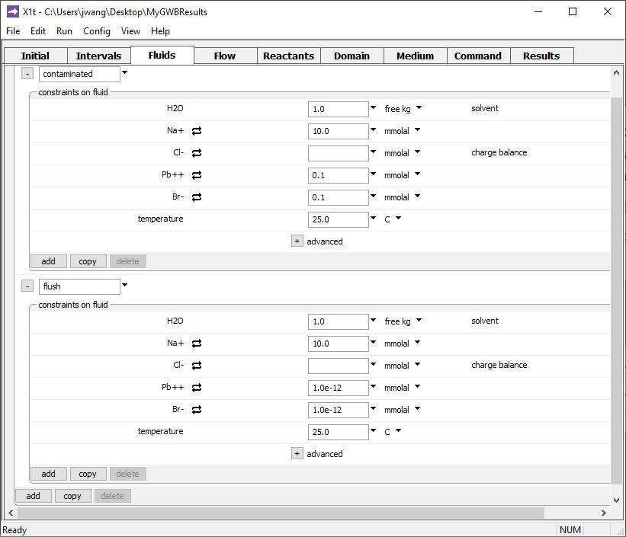
The various inlet fluids are defined on the Fluids pane
Inlet fluid named “contaminated” carries Pb⁺⁺ and Br⁻ into domain
The Br⁻ acts as a tracer in our model.
Clean rinse water: negligible Pb⁺⁺ and Br⁻ in the “flush” inlet fluid
Click to add a new fluid

Slide 5
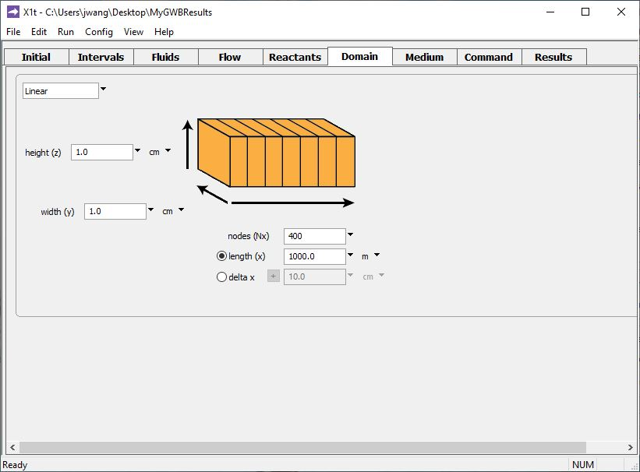
Specify domain size and gridding on the Domain pane.
Domain is 1 km long, divided into 400 nodal blocks

Slide 6
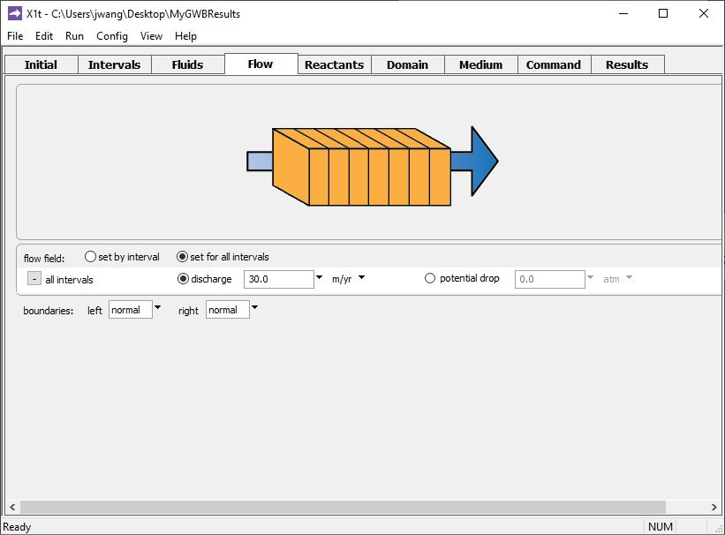
Specify flow rate on the Flow pane.
Set flowrate for 1st and 2nd reaction intervals individually, or set one flowrate for all intervals
Set specific discharge or hydraulic head/ potential drop

Slide 7
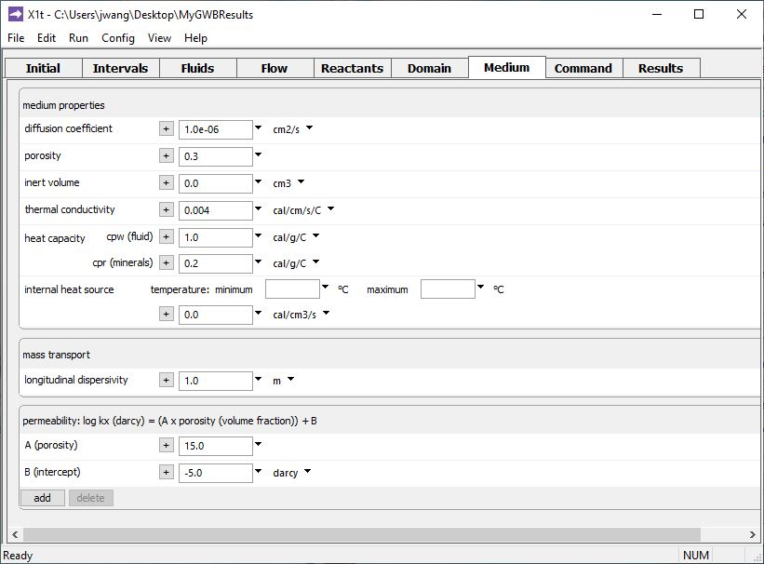
Set various mass transport properties on the Medium pane.
Porosity affects groundwater velocity.
Used to calculate coefficient of hydrodynamic dispersion.

Slide 8
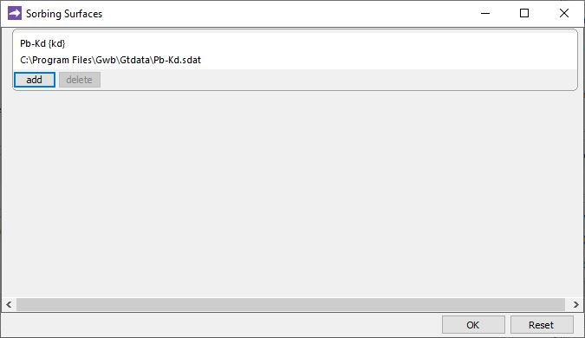
File → Open → Sorbing Surfaces…
Kd describes distribution coefficient between Pb⁺⁺ and aquifer sediments. Br⁻ does not sorb.
You can add any number of Kd, Freundlich, or Langmuir isotherms.
You can also account for ion exchange or surface complexation using the two-layer model.
Run → Go
traces the model

Slide 9
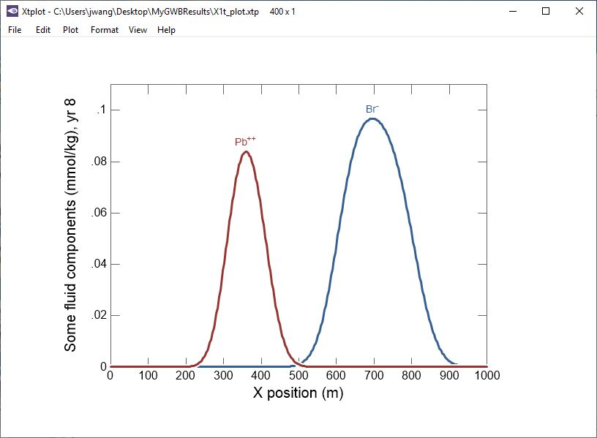
Sorption retards Pb⁺⁺ transport relative to nonreactive tracer Br⁻.

